Slide 1


How To Request a FMV Modification
EngageMate QRC Series
CONFIDENTIAL-FOR INTERNAL USE ONLY
Notes:
Welcome to live training for EngageMate the HIP system replacement.

Slide 2
EngageMate – FMV Modification Tier Change
You can request a Tier Change for the service provider two ways in the system:
  Access the service provider in the Customer Master and request the Tier Change
  Create an activity, add the service provider and then request a Tier change

Slide 3
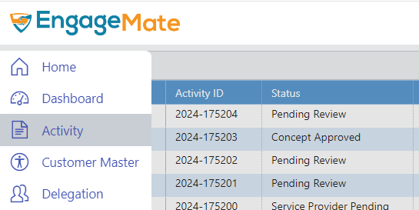
EngageMate – Request Tier Change from Customer Master
1

Slide 4
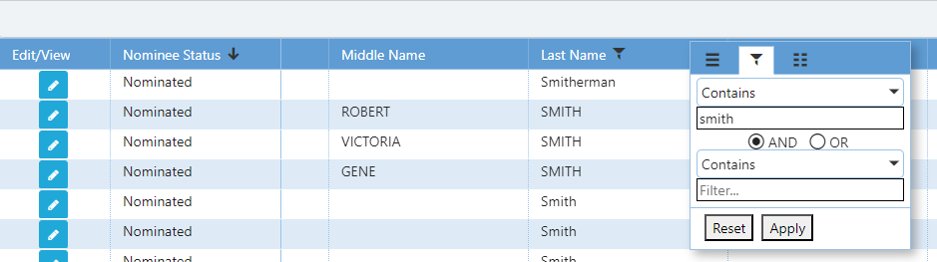
EngageMate – Apply a filter & click edit
2
5
3
4

Slide 5
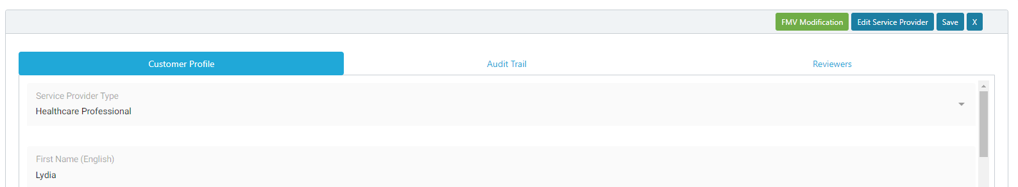
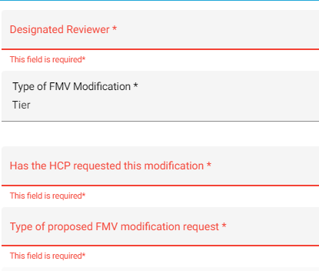
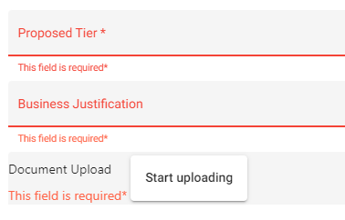
EngageMate – Click FMV Modification & enter required fields
6
7
8

Slide 6
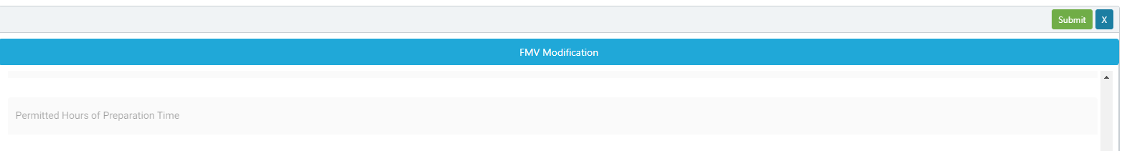
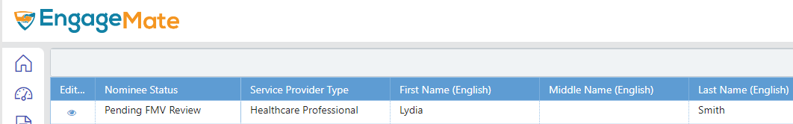
EngageMate – Click submit & confirm the nominee status
9
10

Slide 7
EngageMate – How to Request an FMV Modification in the Activity
The following steps have occurred:
  Created your activity
  Searched for your service provider(s)
  Added the Service Provider(s) to your activity
  Completed the Service Providers Rate, Service Hours, Prep Time & Travel Time
You are ready to complete the FMV Modification form

Slide 8
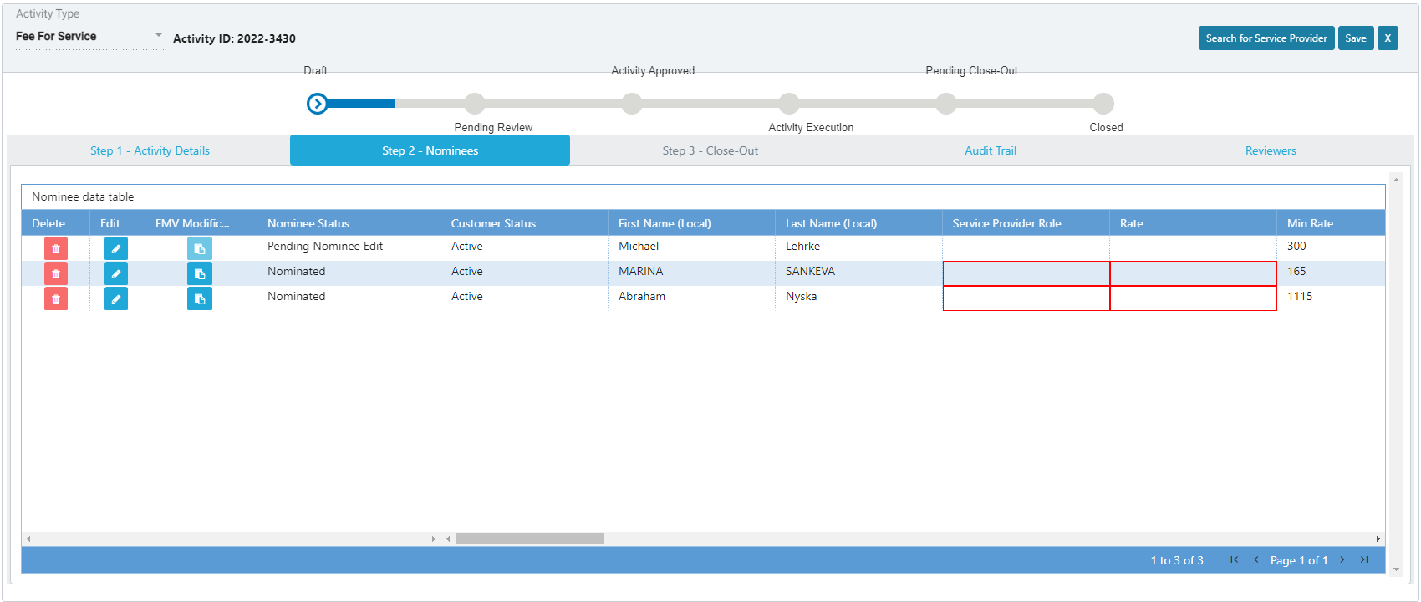

EngageMate – Click the FMV Modification for the service provider
1

Slide 9
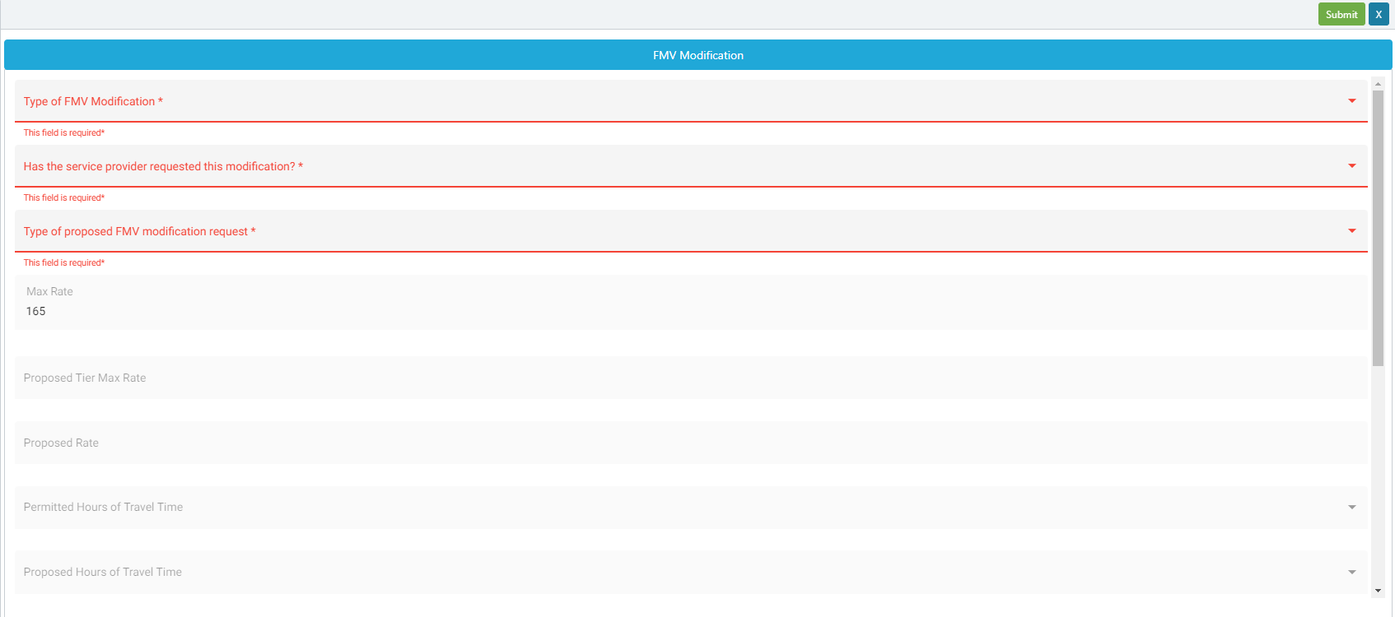
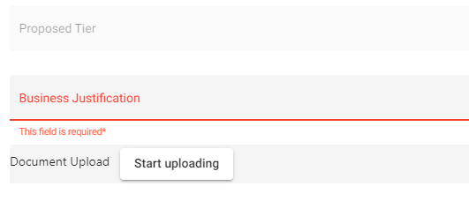
EngageMate – Enter the required fields & submit
4
2
3

Slide 10
EngageMate – Confirm the Nominee Status is changed

Slide 11
Congratulations! You have requested an FMV Modification.
To view a video on “How to Request an FMV Modification”, visit Teva Tube:

