Slide 1


How To Request a FMV Modification
EngageMate QRC Series
CONFIDENTIAL-FOR INTERNAL USE ONLY
Notes:
Welcome to live training for EngageMate the HIP system replacement.

Slide 2
EngageMate – How to Request an FMV Modification
The following steps have occurred:
  Created your activity
  Searched for your service provider(s)
  Added the Service Provider(s) to your activity
  Edited the Service Providers profile to include Rate, Prep Time, etc.
You are ready to complete the FMV Modification form

Slide 3
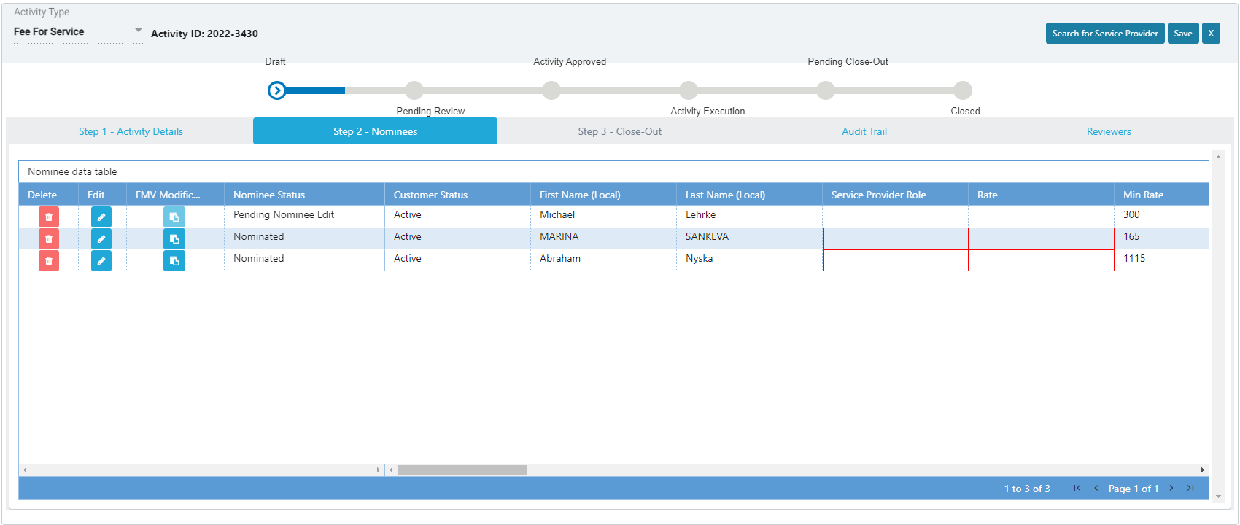

EngageMate – Click the FMV Modification icon for the SP needing the modification
1

Slide 4
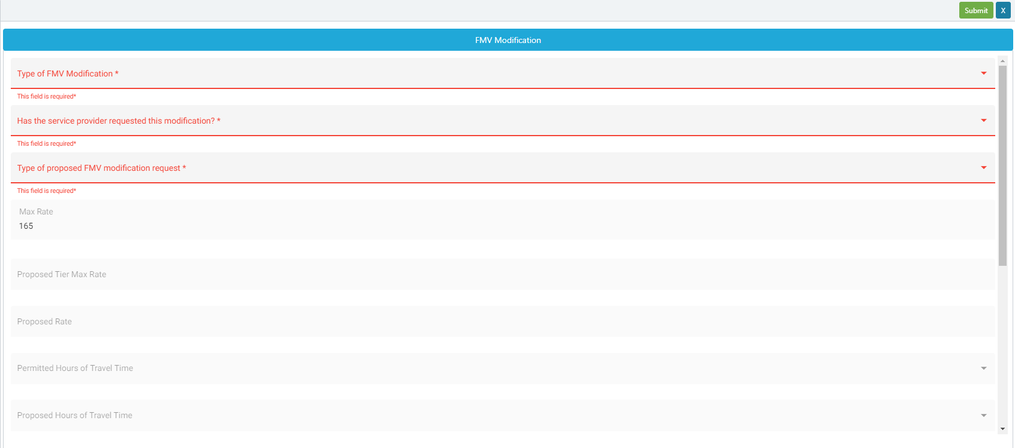
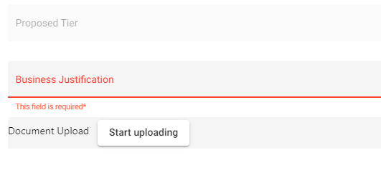
EngageMate – Select the Modification Type & Enter Justification
4
2
3
Reminder: Fill in the the type of modification being requested, and don’t forget to save & submit your modification request.

Slide 5
EngageMate – After submitting, confirm the Nominee Status is Updated

Slide 6
Congratulations! You have requested an FMV Modification.
To view a video on “How to Request an FMV Modification”, visit Teva Tube:
https://vod.tevapharm.com/media/EM+Submitter+3+-+FMV+Modification/1_11wbxpu4

