Slide 1


How To Edit a Service Provider
EngageMate QRC Series
CONFIDENTIAL-FOR INTERNAL USE ONLY
Notes:
Welcome to live training for EngageMate the HIP system replacement.

Slide 2
EngageMate – How to Edit a Service Provider
You can edit the service provider profile two ways in the system:
  Access the service provider in the Customer Master and submit your edit
  Create an activity and then edit the service provider once you add them to the activity

Slide 3
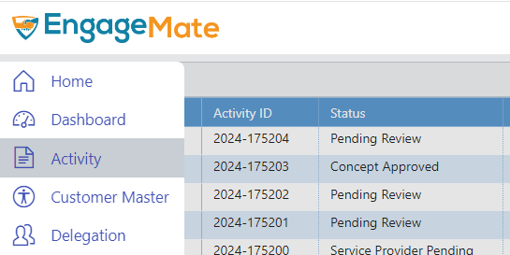
EngageMate – How to Edit from the Customer Master
1

Slide 4
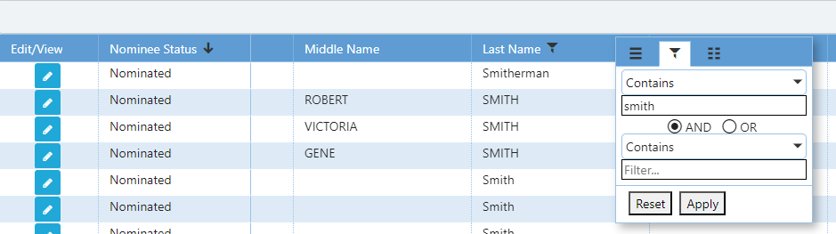
EngageMate – Apply a Filter & click Edit
2
5
3
4

Slide 5
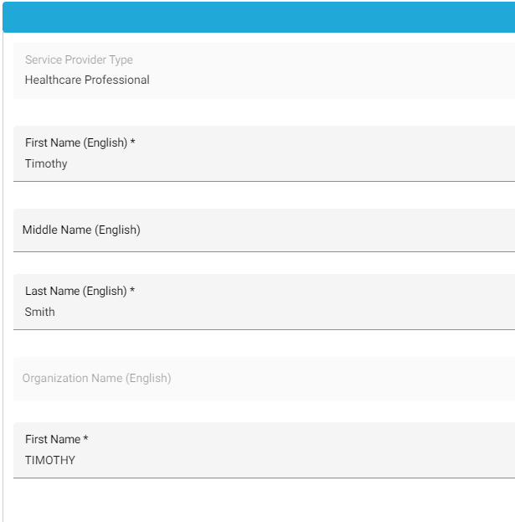
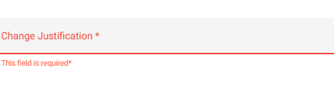
EngageMate – Update the profile & enter your change justification
6
7

Slide 6
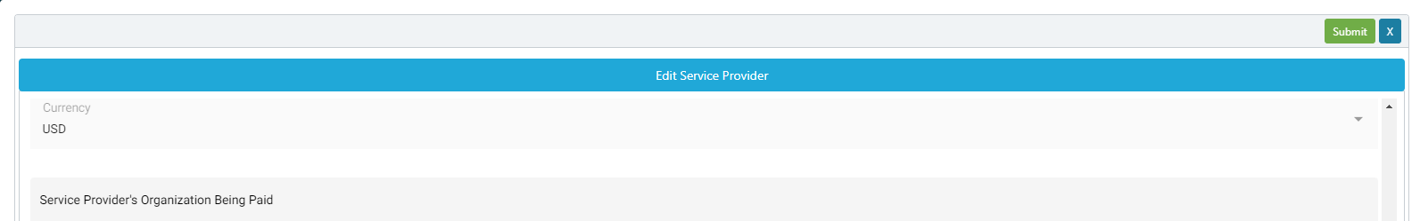
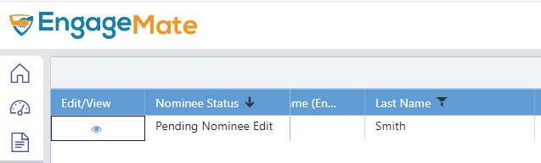
EngageMate – Submit & the Nominee Status is changed
8
9

Slide 7
EngageMate – How to Edit a Service Provider
The following steps have occurred:
  Created your activity
  Searched for your service provider(s)
  Added the Service Provider(s) to your activity

Slide 8
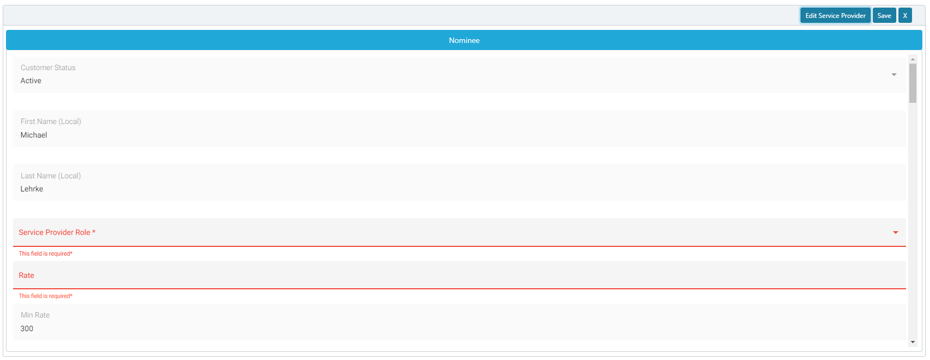
EngageMate – Click the Edit Service Provider
1

Slide 9
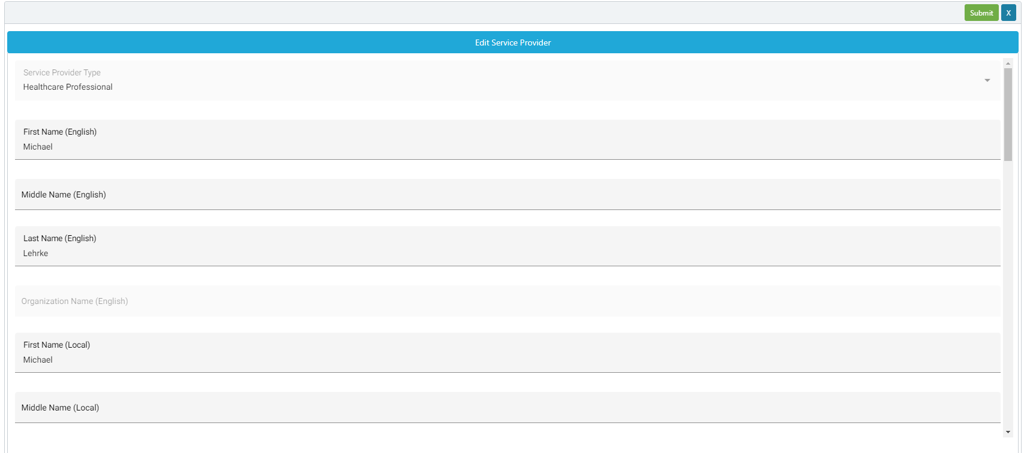
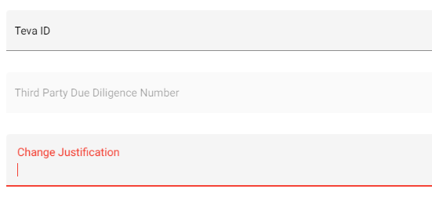
EngageMate – Update the profile, enter justification & submit
4
2
3

Slide 10
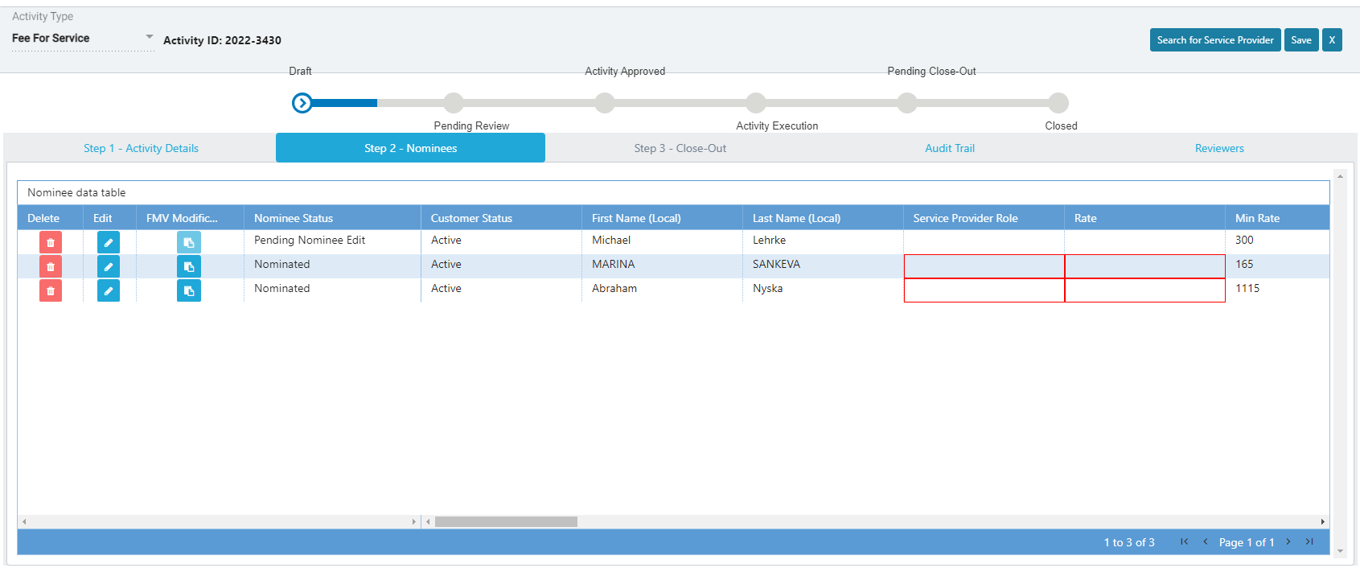
EngageMate – After submitting, confirm the Nominee Status is updated

Slide 11
Congratulations! You have edited a Service Provider’s profile.
To view a video on “How to Edit a Service Provider”, visit Teva Tube:

