Slide 1


How To Edit a Service Provider
EngageMate QRC Series
CONFIDENTIAL-FOR INTERNAL USE ONLY
Notes:
Welcome to live training for EngageMate the HIP system replacement.

Slide 2
EngageMate – How to Edit a Service Provider
The following steps have occurred:
  Created your activity
  Searched for your service provider(s)
  Added the Service Provider(s) to your activity

Slide 3
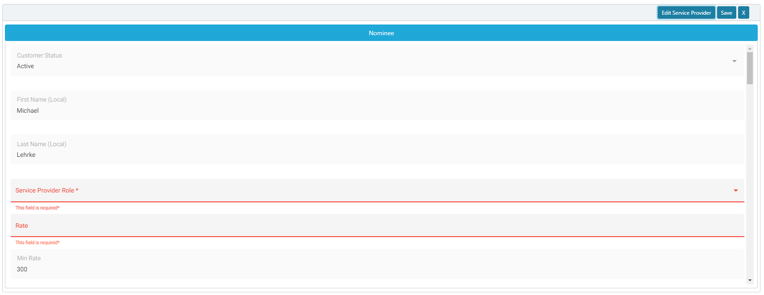
EngageMate – Click the Edit Service Provider
1

Slide 4
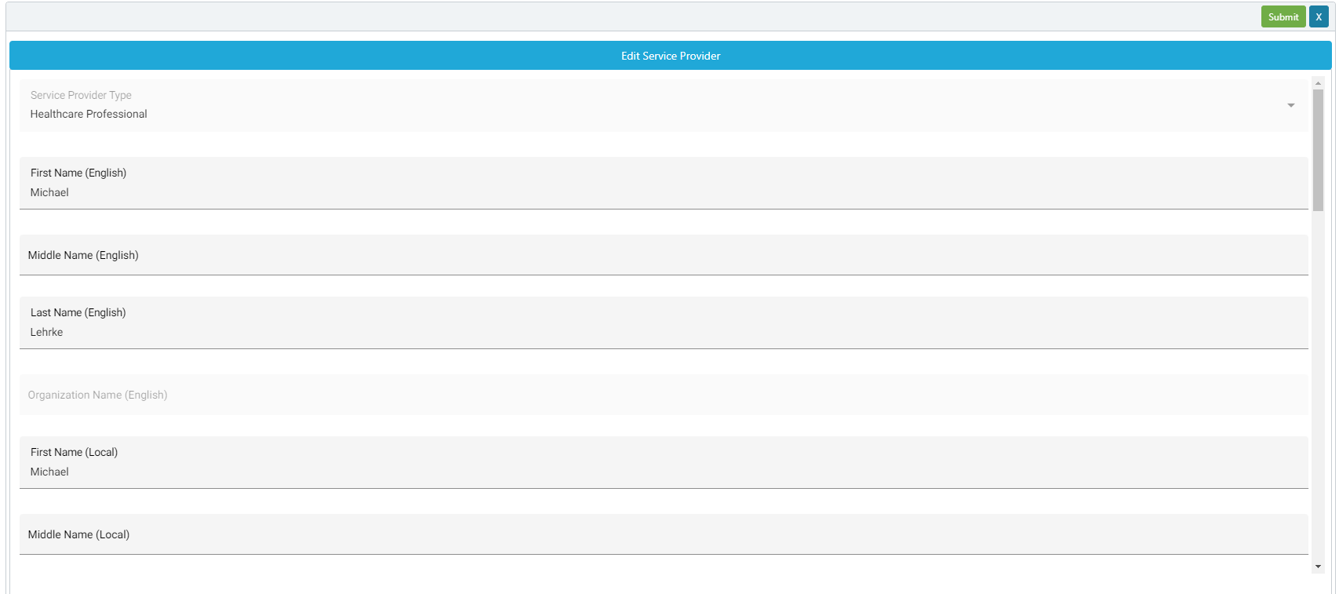
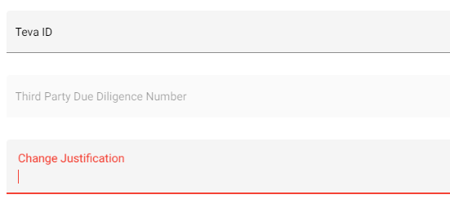
EngageMate – Update the Service Provider fields, & enter justification
4
2
3
Reminder: Don’t forget to save & submit your modification request.

Slide 5
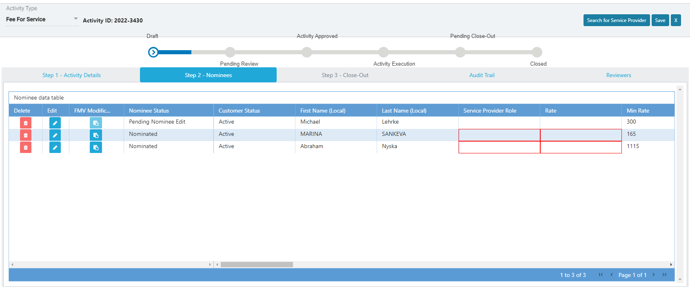
EngageMate – After submitting, confirm the Nominee Status is updated

Slide 6
Congratulations! You have edited a Service Provider’s profile.
To view a video on “How to Edit a Service Provider”, visit Teva Tube:
https://vod.tevapharm.com/media/EM+Submitter+5+-+Editing+the+Service+Provider+Profile/1_lgnp9zpz

