Slide 1


How To Create An Activity
EngageMate QRC Series
CONFIDENTIAL-FOR INTERNAL USE ONLY
Notes:
Welcome to live training for EngageMate the HIP system replacement.

Slide 2
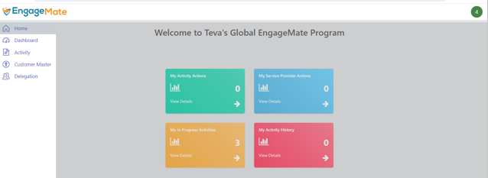
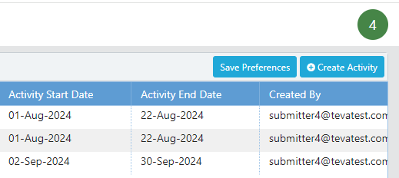
EngageMate – How to Create an Activity
1
2

Slide 3
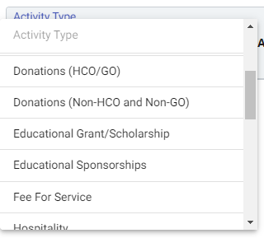
EngageMate – Select your Activity Type
3

Slide 4
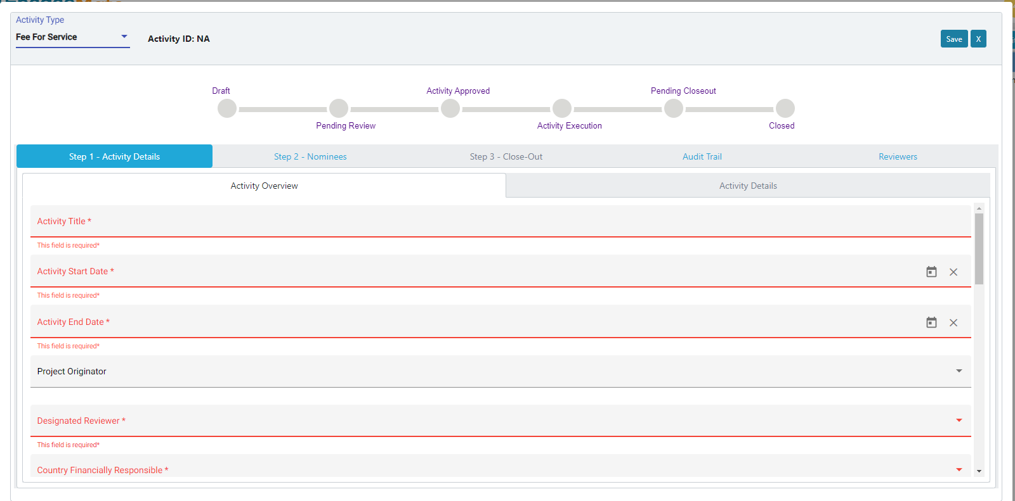
EngageMate – Complete the fields for your activity
5
4
4.1
Hint: Red fields are required – they must be completed before submitting the activity

Slide 5
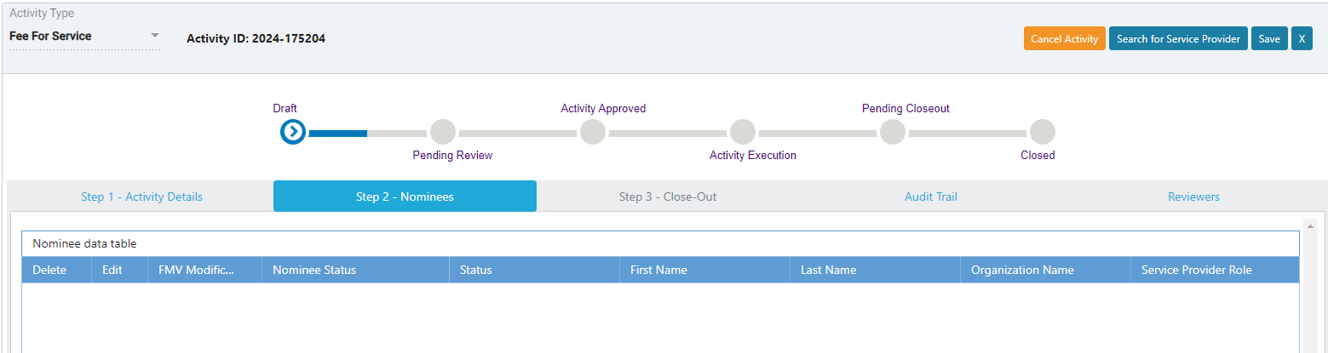
EngageMate – Search for your Service Providers
7
6

Slide 6
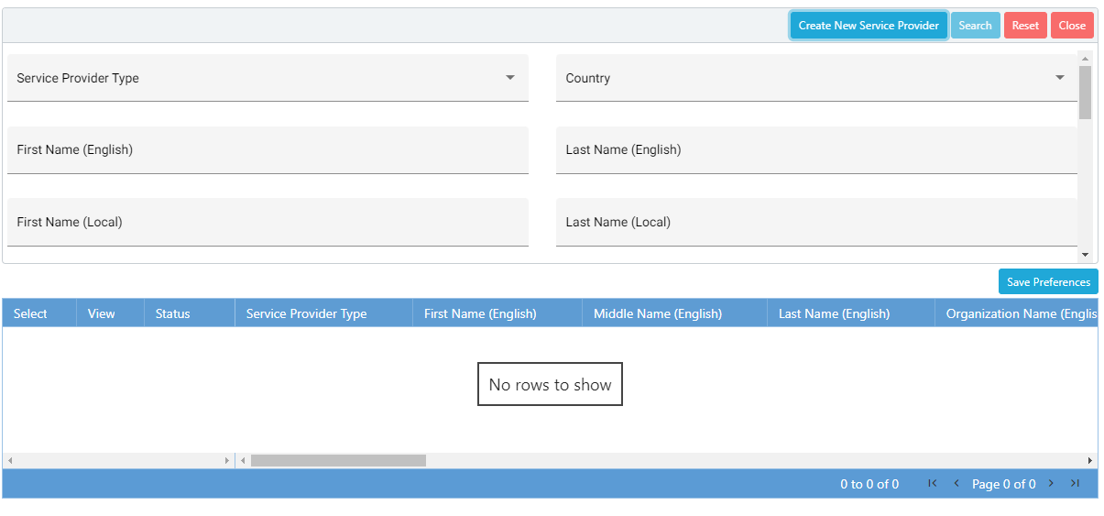
EngageMate – Enter Search Criteria (Name, Service Provider Type, etc.)
8

Slide 7
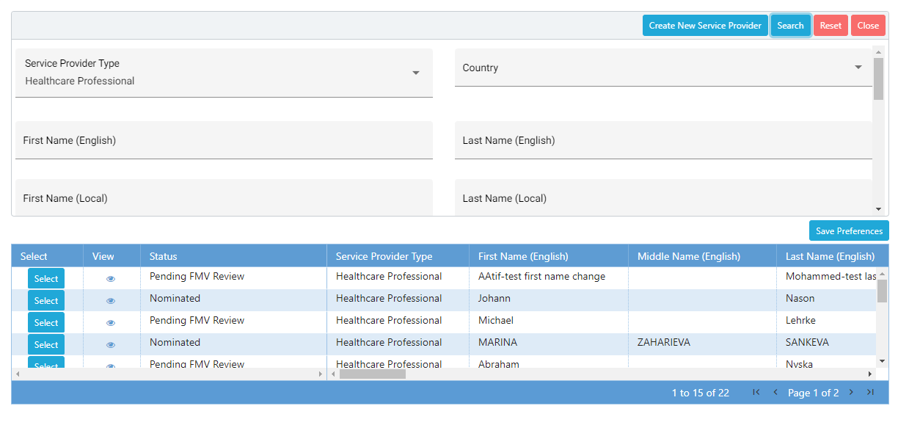
EngageMate – Search for and select your Service Provider(s), & Close
9
12
10
11

Slide 8
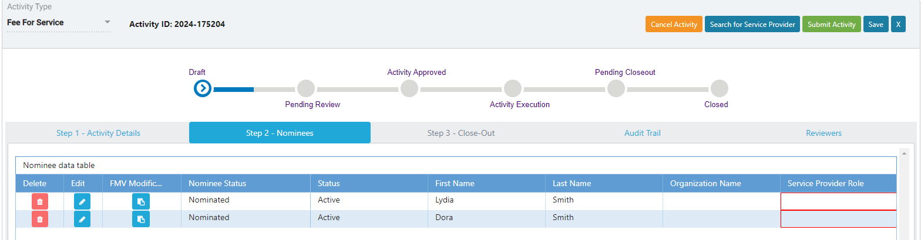
EngageMate – Click Edit
13

Slide 9
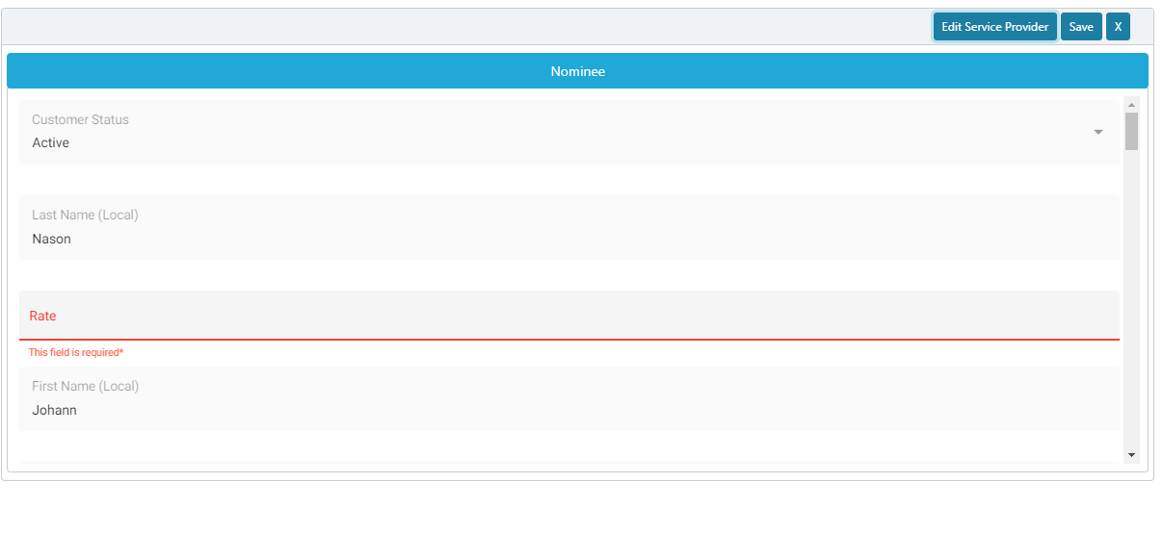
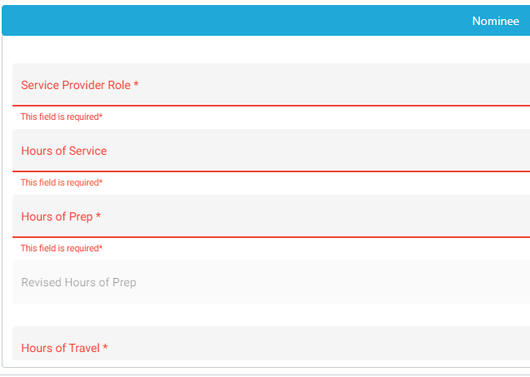
EngageMate – Complete the required fields & click save
19
15
14
16
17
18

Slide 10
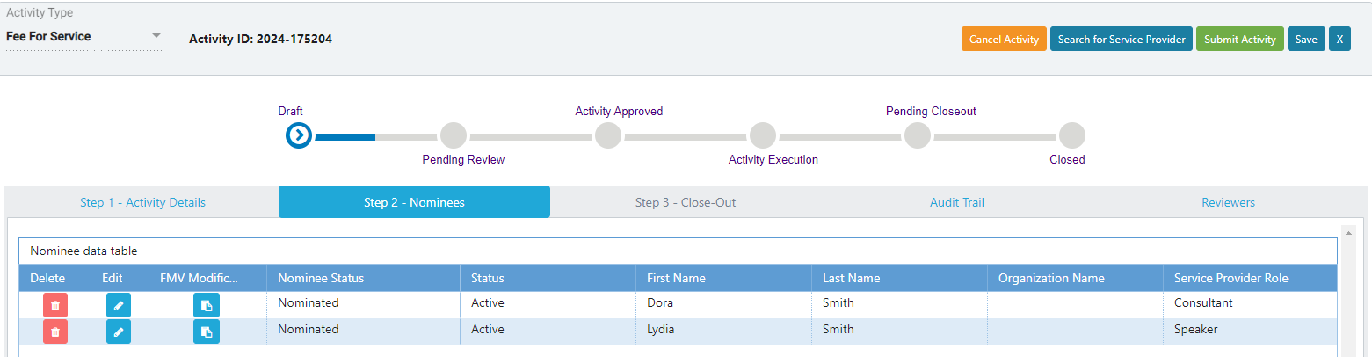
EngageMate – Submit your Activity
20

Slide 11
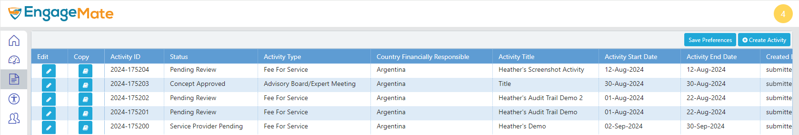
EngageMate – After submitting, confirm your Activity’s status is updated

Slide 12
Congratulations! You created an activity.
To view video on “How To Create an Activity”, visit to Teva Tube:

