Slide 1
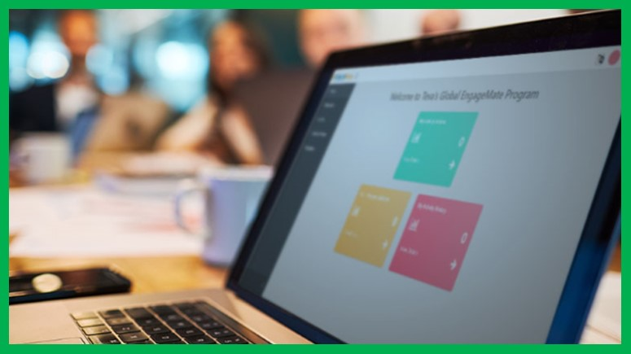

How To Close-Out An Activity
EngageMate QRC Series
CONFIDENTIAL-FOR INTERNAL USE ONLY
Notes:
Welcome to live training for EngageMate the HIP system replacement.

Slide 2
EngageMate – How to Close-out an Activity
The following steps have occurred:
  Created your activity
  Your activity was approved
  It is now 1 day after the start date of your activity
  You are ready to complete the close-out steps

Slide 3
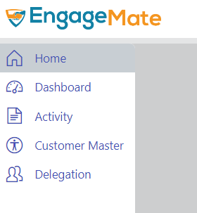
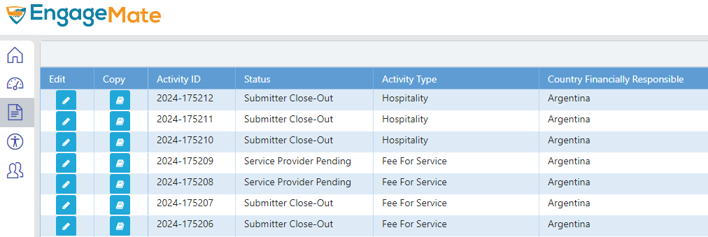
EngageMate – Locate the Activity to close-out
1
2

Slide 4
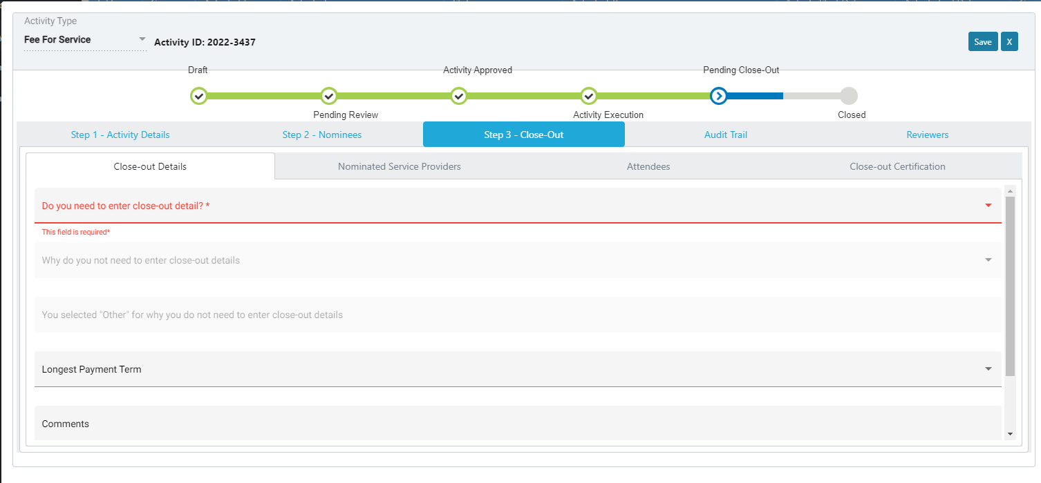
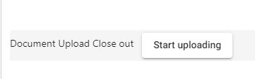
EngageMate – Click on the tab named Close-out
3
4
5

Slide 5
EngageMate – Activity to close-out
How to: Manual Data Entry of Service Provider
Spend Details/Expense Types
*Tip: Process is similar for both Service Providers and Attendees with expenses. Difference is the close-out tab selected to enter expense data

Slide 6
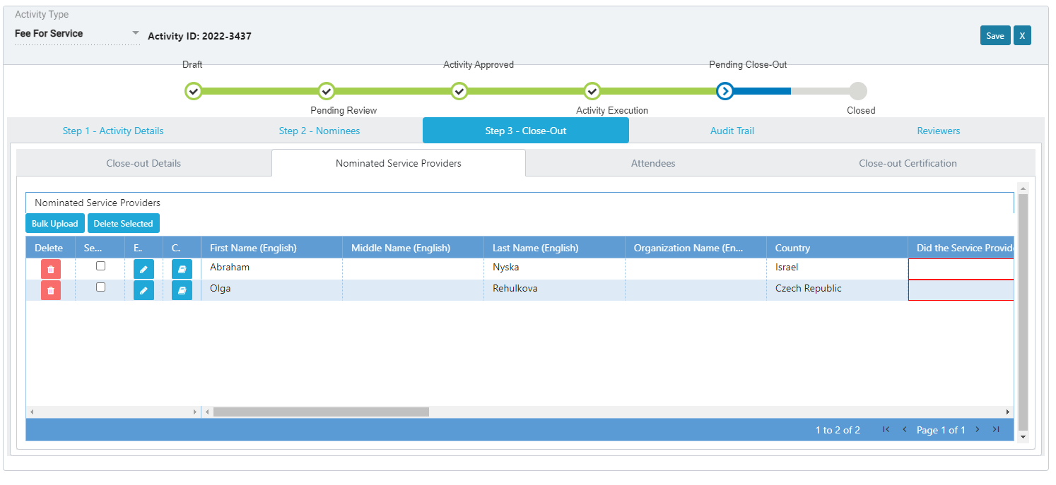
EngageMate – Click the Nominated Service Providers tab
6
7

Slide 7
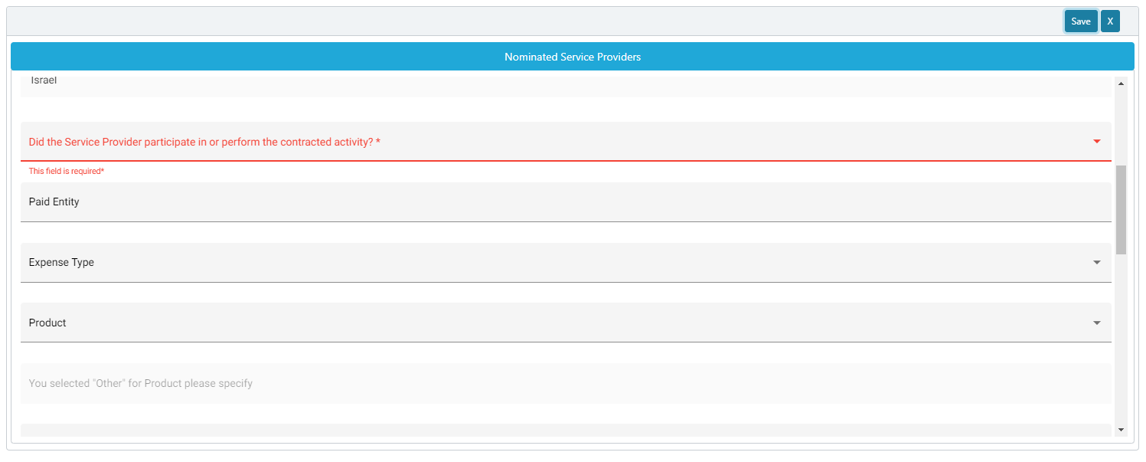
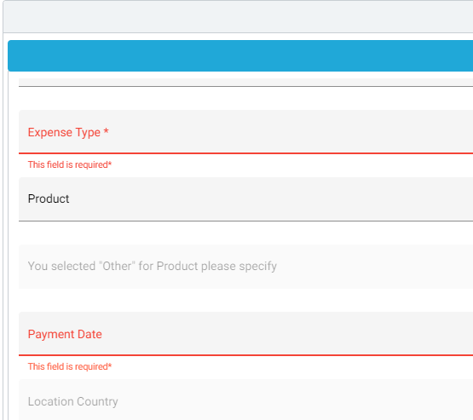
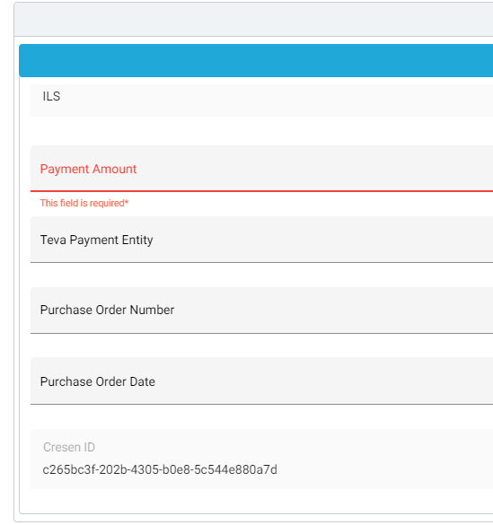
EngageMate – Complete the required fields & click Save
12
8
If “Yes” is selected
9
11
10

Slide 8
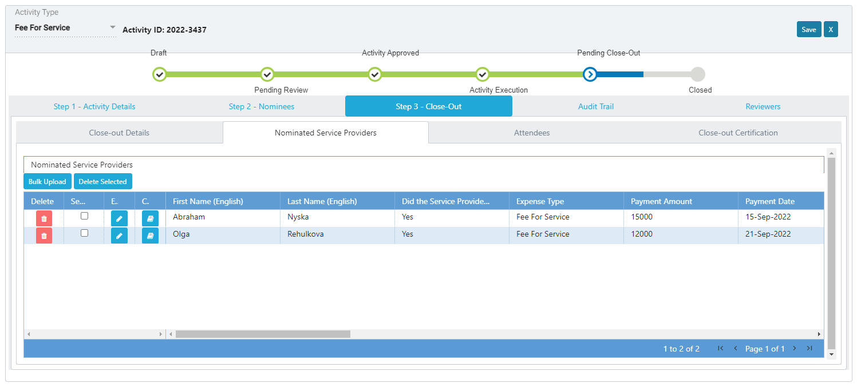
EngageMate – Complete process for each Service Provider

Slide 9
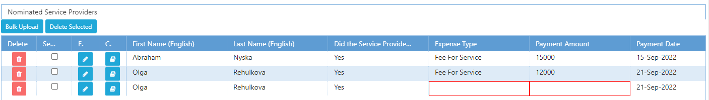
EngageMate – TIP: Use copy feature for multiple expense entries
12.1
12.2

Slide 10
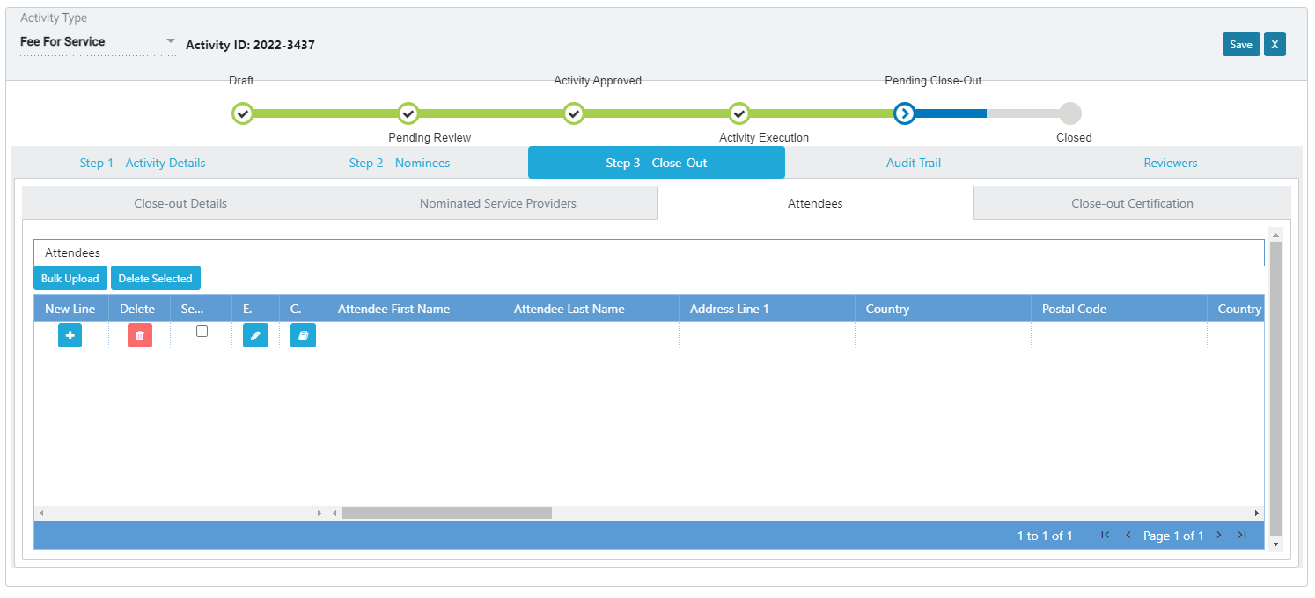
EngageMate – Attendees with Spend? Use the Edit & New buttons
13
13.2
13.1

Slide 11
EngageMate – Activity to close-out
How to: Bulk Upload Spend/Expense Using Template
(Service Provider Spend)

Slide 12
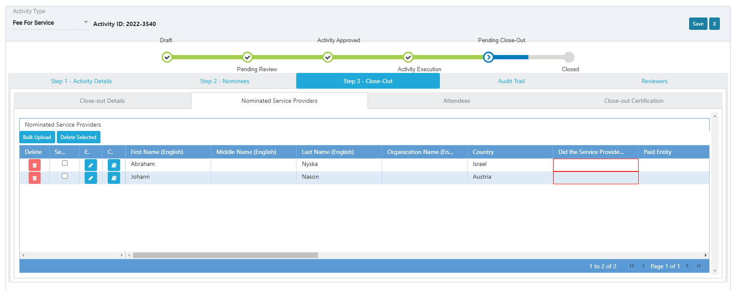
EngageMate – Click the Nominated Service Providers tab
6
7

Slide 13
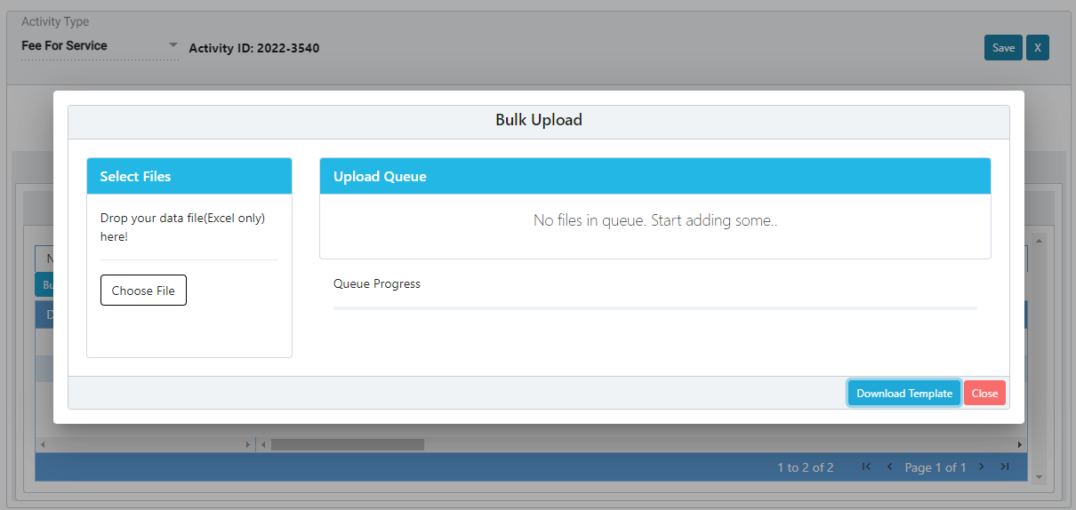
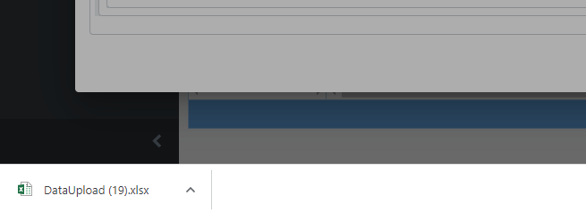
EngageMate – Download the Template
8
9

Slide 14
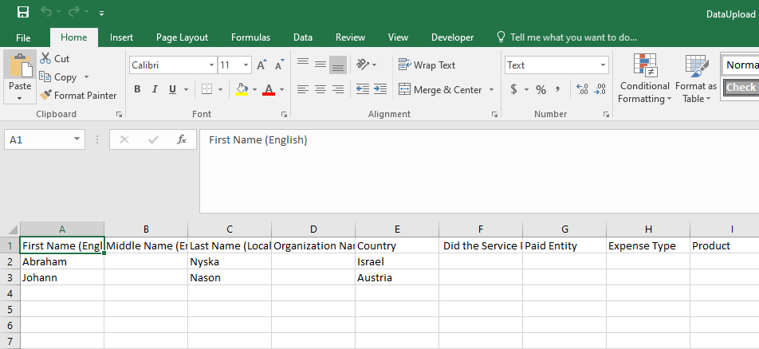
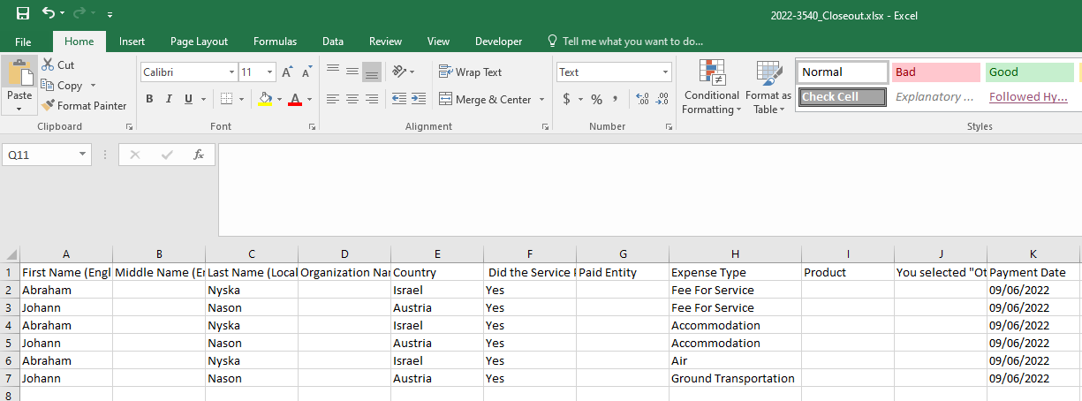
EngageMate – Open downloaded template, complete the data & save the file
TIP: Copy and paste rows if you have more then one spend type
STOP: You cannot add spend for Service Providers not previously nominated
11
10

Slide 15
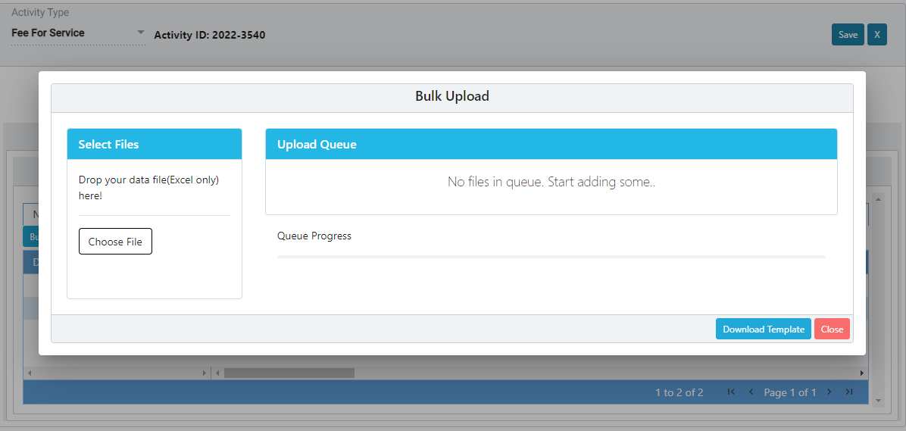
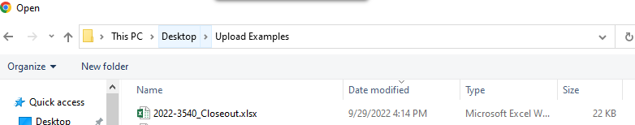
EngageMate – Select your saved file to upload
12
13

Slide 16
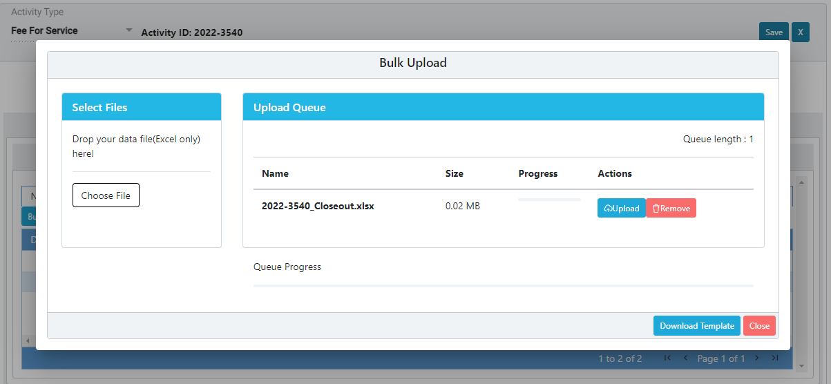
EngageMate – Upload your completed file
14

Slide 17
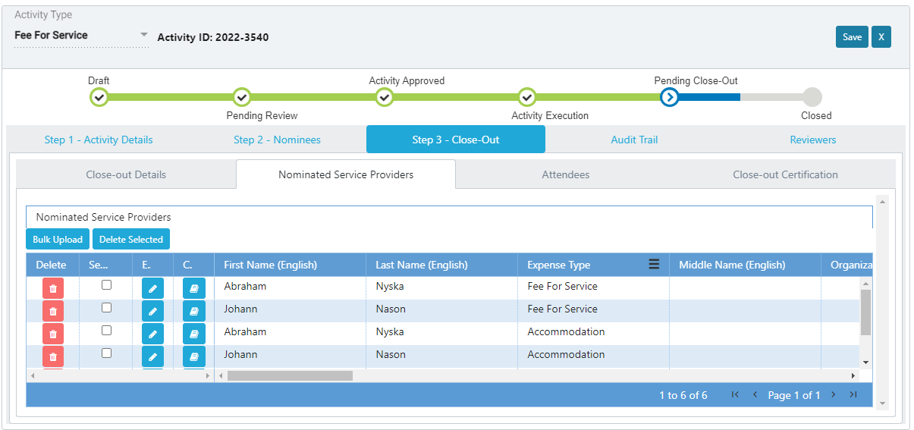
EngageMate – Confirm data upload (cells are populated)

Slide 18
EngageMate – Activity to close-out
How to: Bulk Upload Spend/Expense Using Template
(Attendee Spend)

Slide 19
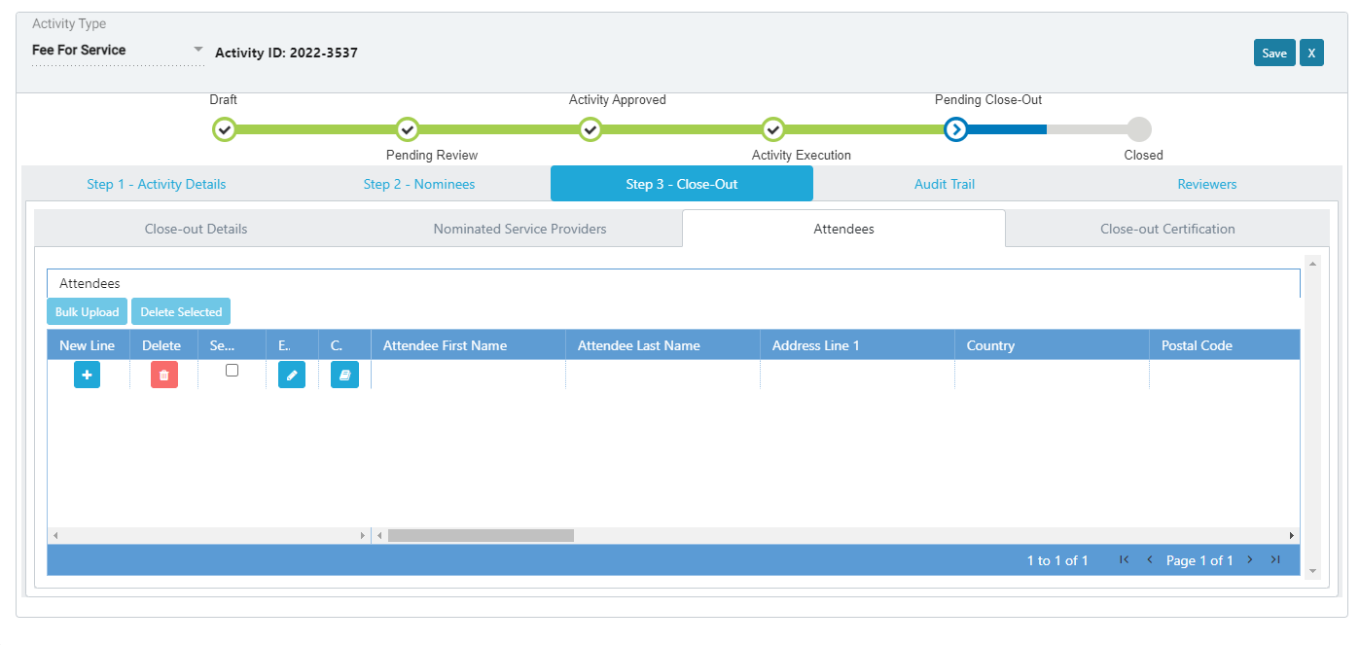
EngageMate – Click the Attendees tab
6
7

Slide 20
EngageMate – Attendee Spend
Process Tips:
Attendees do not require profiles in Customer Master (like Service Providers)
Attendee spend follows similar bulk upload process for Service Provider
There are mandatory fields requiring data:
  Attendee First & Last Name
  Attendee Address, Country, Postal Code
  Attendee Identifier Type and Identification Number
  Expense Type (meals, lodging, etc.)
  Expense Amount
  Expense Payment Date (format of 1–Nov–2022)

Slide 21
EngageMate – Activity to close-out
How to: Certify and Close the Activity

Slide 22
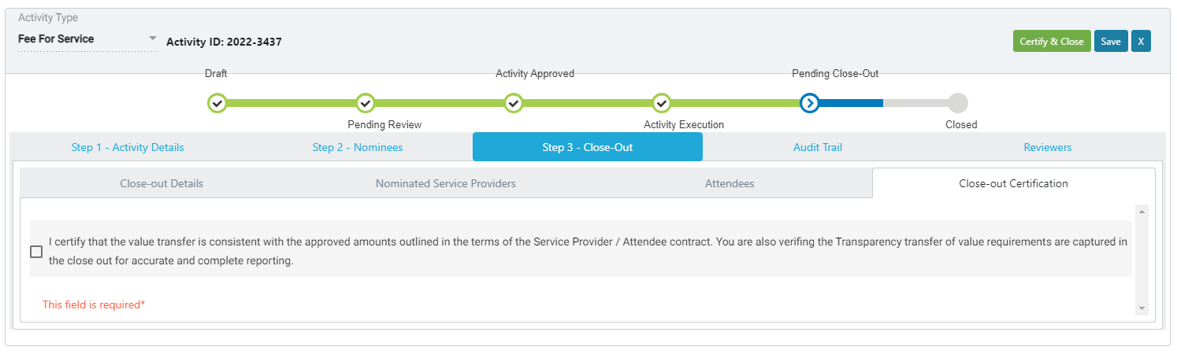
EngageMate – After Completing Spend Data Entry
Scenario: No Project Originator was selected for this Activity
17
15
16

Slide 23
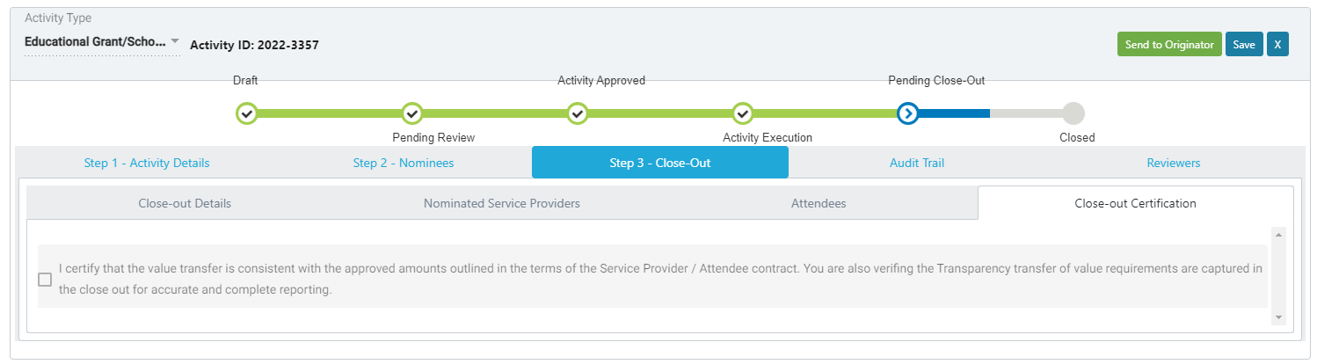
EngageMate – Complete Spend Data Entry & send to Project Originator for Certification
Scenario: Project Originator was selected for this Activity
16
15

Slide 24
Congratulations! You have closed-out an activity.
To view video on “How To Close-Out an Activity”, visit to Teva Tube:

