Slide 1


Reviewers
EngageMate QRC Series
CONFIDENTIAL-FOR INTERNAL USE ONLY
Notes:
Welcome to live training for EngageMate the HIP system replacement.

Slide 2

Reviewers
How To Review An Activity to Approve, Reject or Request More Information
How to Certify and Close, as a Project Originator
Review an FMV Modification
Upload Documents – not shown

Slide 3
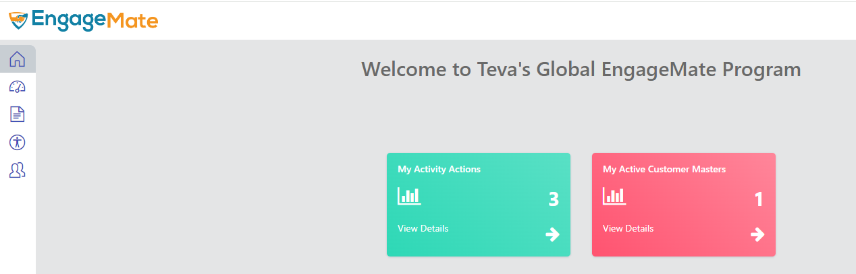
EngageMate – How to Review and Approve an Activity
1

Slide 4
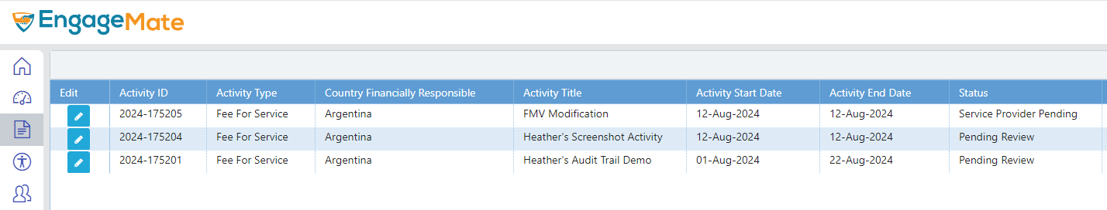
EngageMate – Select your Activity to review
2

Slide 5
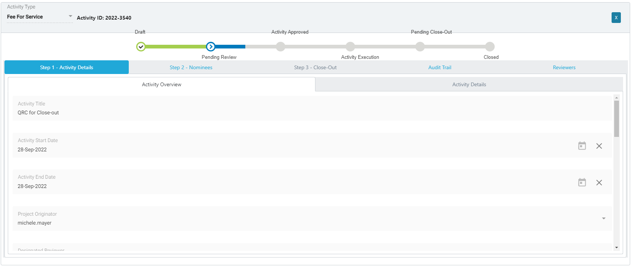
EngageMate – Start with Step 1 tab & review all fields in the tabs under step 1
3
4
TIP: As a Reviewer it is your responsibility to ensure submission is Accurate and Complete. Thoroughly review the submission before you select approve.

Slide 6
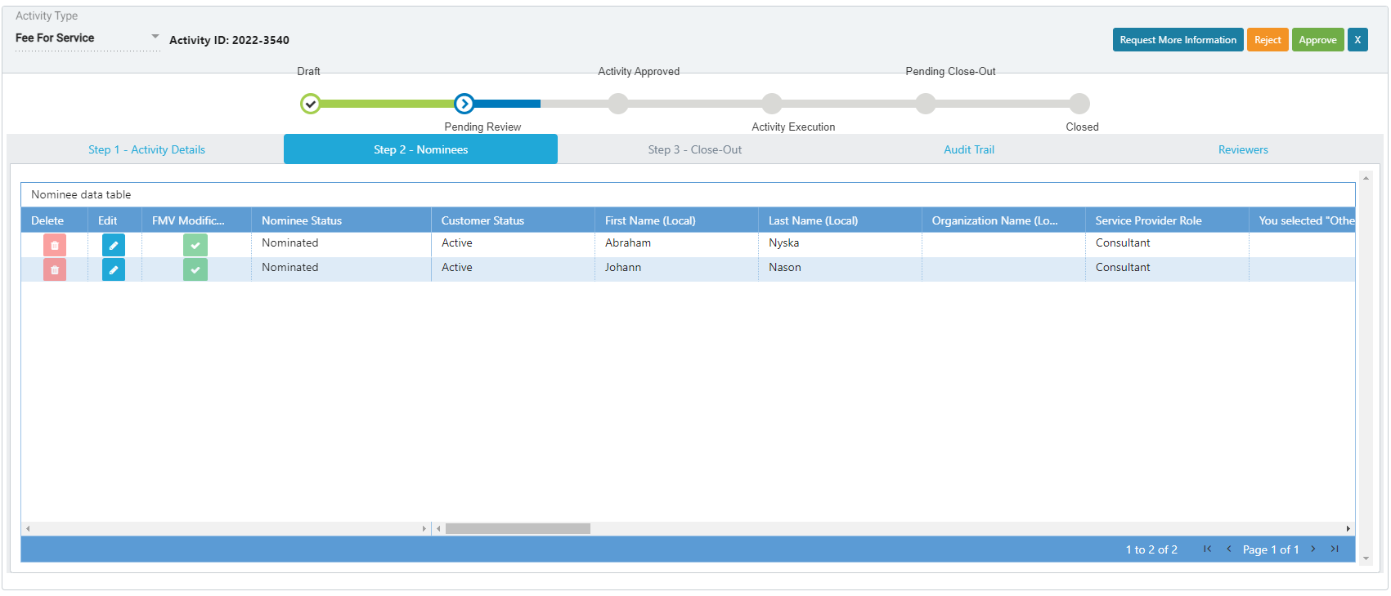
EngageMate – Review all the Nominees – Step 2 - Nominees
5
6
TIP: As a Reviewer it is your responsibility to ensure submission is Accurate and Complete. Thoroughly review the submission before you select approve.

Slide 7
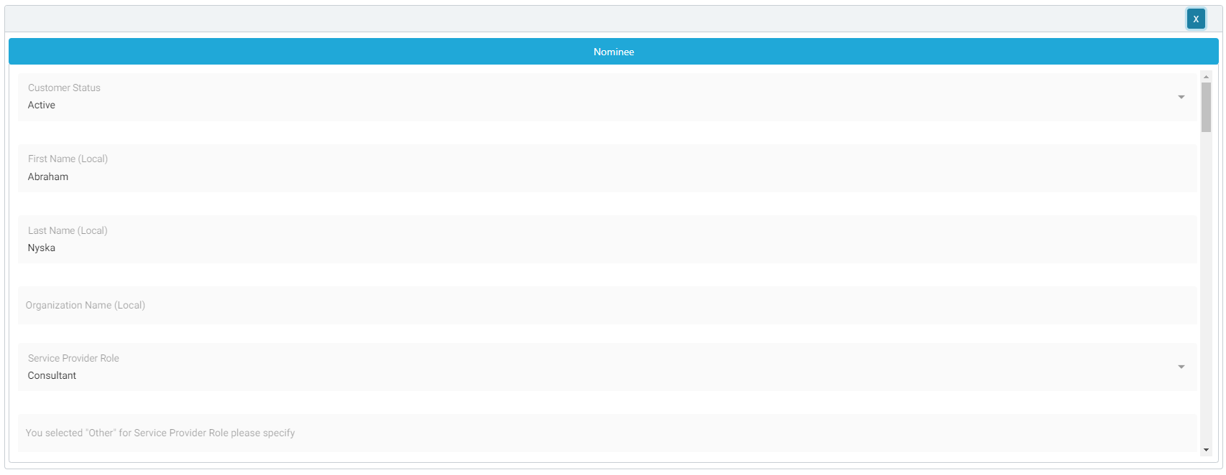
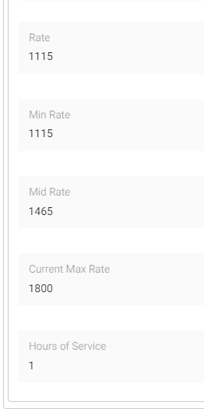
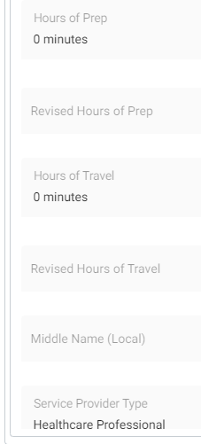
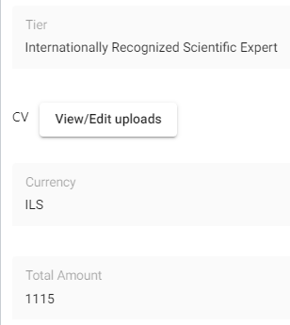
EngageMate – Review all data entered for each Nominee
8
7
TIP: As a Reviewer it is your responsibility to ensure submission is Accurate and Complete. Thoroughly review the submission before you select approve.

Slide 8
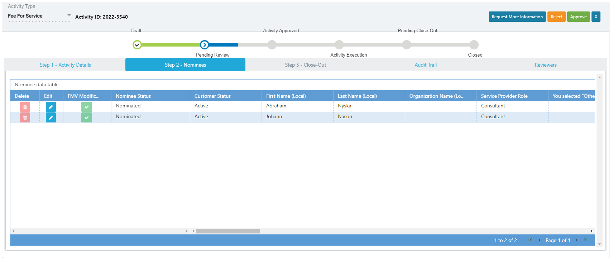
EngageMate – To Approve an Activity
9

Slide 9
Congratulations!
You have approved an activity.
To view video on “How To Review & Approve an Activity”, visit to Teva Tube:

Slide 10
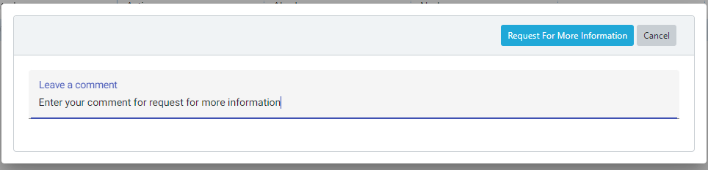
EngageMate – To Request More Information for an Activity
9
9.2
9.1
TIP: Enter detail in the comments to allow submitter’s understanding of your request

Slide 11
You have now requested more information for an activity.
To view video on “How To Request More Information, as a Reviewer”, visit to Teva Tube:

Slide 12
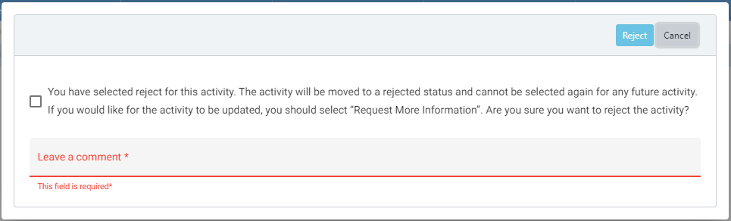
EngageMate – To Reject an Activity
9
9.3
9.1
9.2

Slide 13
You have now rejected an activity.
To view video on “How To Reject an Activity, as a Reviewer”, visit to Teva Tube:

Slide 14
EngageMate – Approve an FMV Modification (as a Designated Reviewer)
1
Tip: If the FMV Modification is part of the Activity then click the My Activity Actions tile

Slide 15
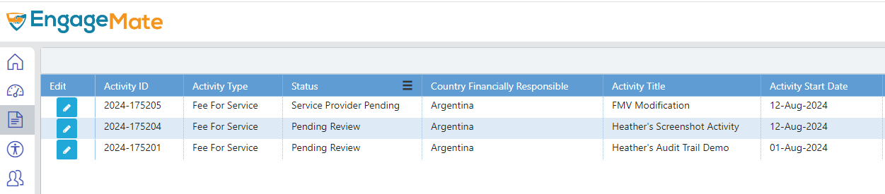
EngageMate – Locate the Activity that includes an FMV Modification
2

Slide 16
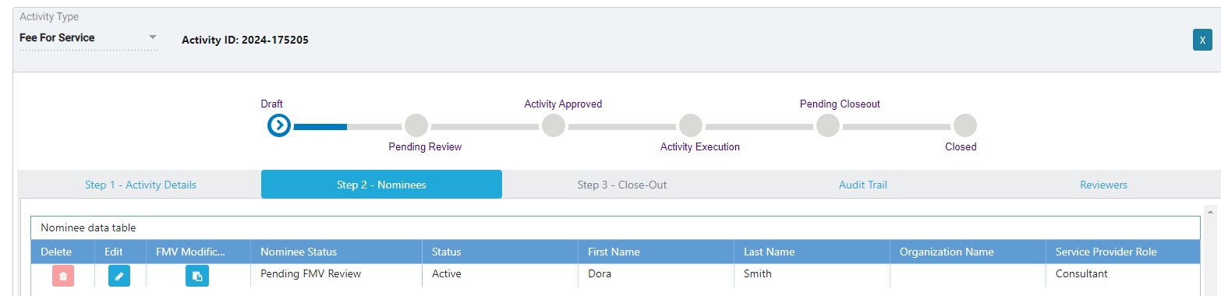
EngageMate –Open the FMV Modification (as a Designated Reviewer)
3
4

Slide 17
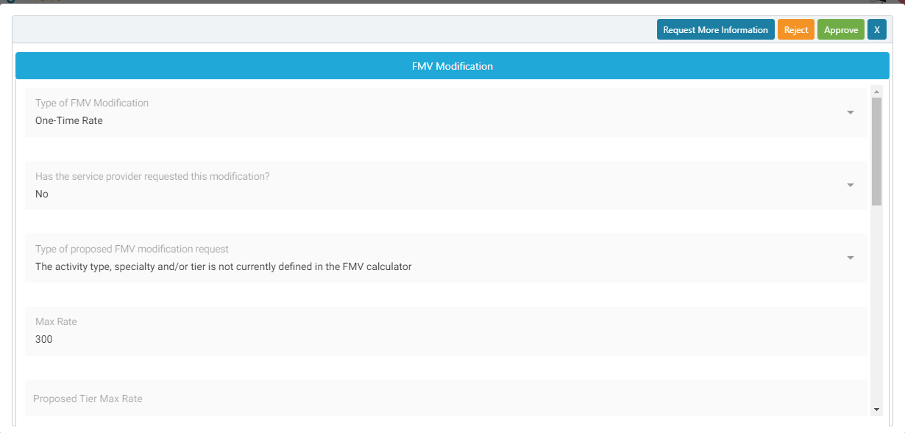
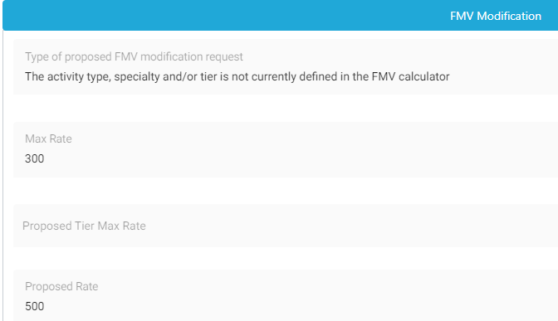

EngageMate – Review all information entered
5
6
7
This is why I am submitting this request

Slide 18
EngageMate – Select your decision (as the Designated Reviewer)
8

Slide 19
You have now reviewed an FMV Modification from the activity, as a Designated Reviewer.

Slide 20
EngageMate – Approve an FMV Modification (as a Designated Reviewer)
1
Tip: If the FMV Modification Tier Change is submitted from the Customer Master then click the My Active Customer Masters tile

Slide 21
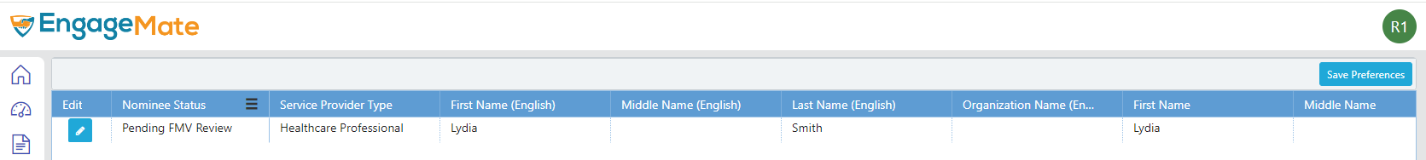
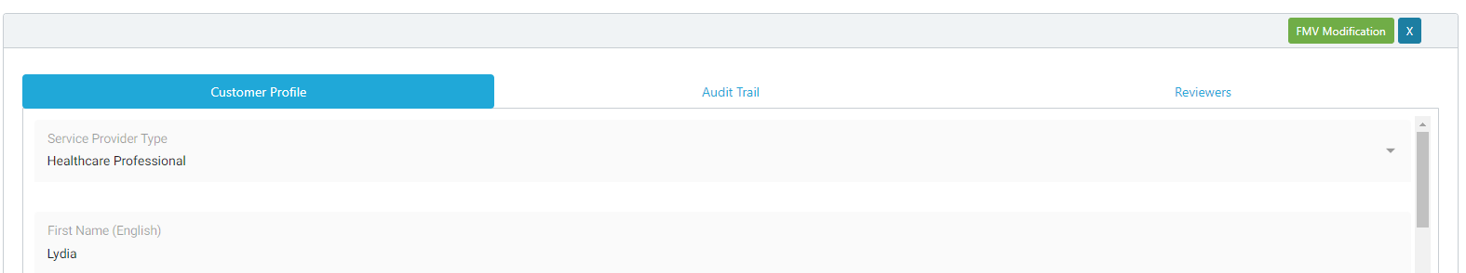
EngageMate – Locate the Service Provider that has an FMV Modification
2
3

Slide 22
EngageMate – Review all information entered
4
5
6
This is why I am submitting this request

Slide 23
EngageMate – Select your decision (as the Designated Reviewer)
7

Slide 24
You have now reviewed an FMV Modification Tier Change from the Customer Master, as a Designated Reviewer.

Slide 25
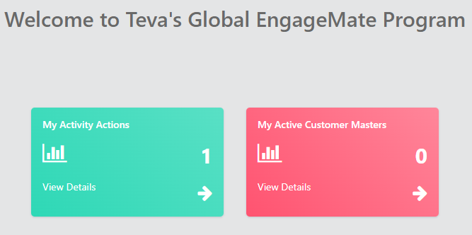
EngageMate – Certify and Close an Activity (as a Project Originator)
1

Slide 26
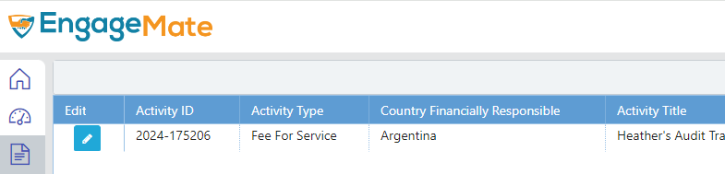
EngageMate – Locate the Activity to certify (as a Project Originator)
2

Slide 27
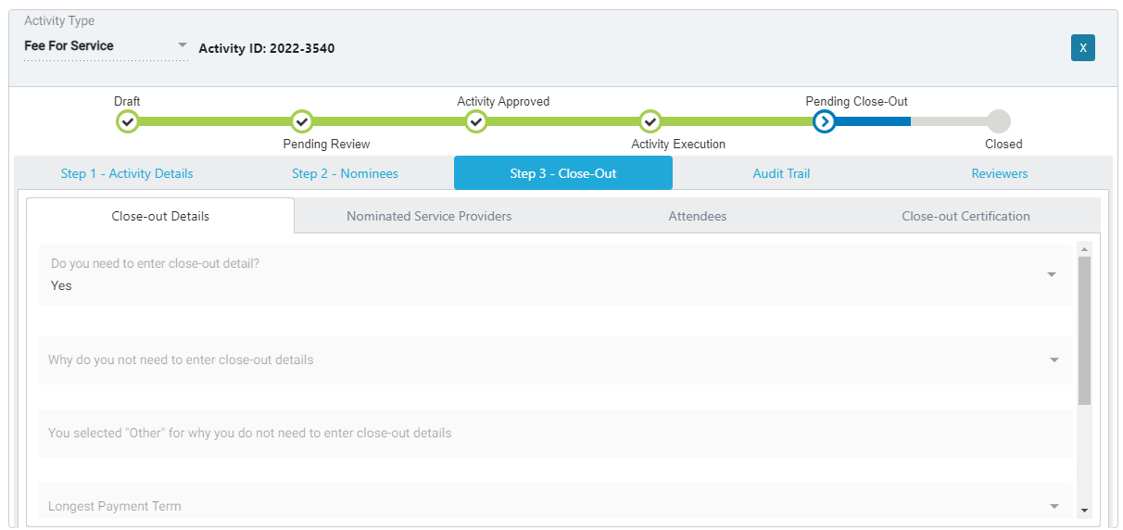
EngageMate – Review each tab and information entered (as a Project Originator)
3
4
6
5

Slide 28
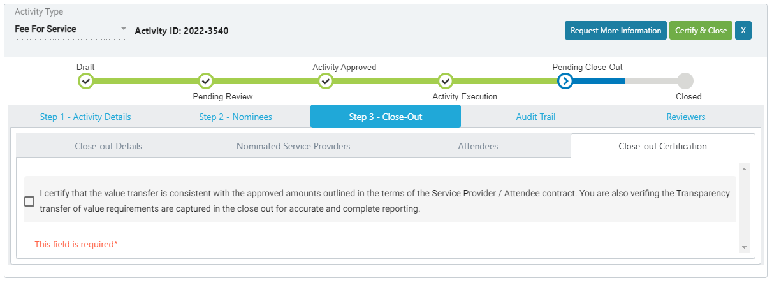
EngageMate – Certify & Close Step (as a Project Originator)
7
9
8

Slide 29
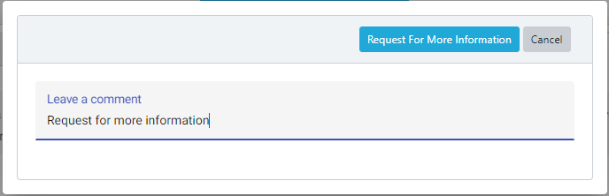
EngageMate – Request More Information (as Project Originator)
7
8
10
9

Slide 30
Congratulations! You have Reviewed, Certified and Closed an activity, as a Project Originator.
To view video on “How To Certify and Close an Activity, as a Project Originator”, visit to Teva Tube:

