Slide 1


Reviewers:
1) How To Review An Activity for Approval, Rejection or Request More Information
2) How to Certify and Close, as a Project Originator
EngageMate QRC Series
CONFIDENTIAL-FOR INTERNAL USE ONLY
Created: October 2022 v1
Notes:
Welcome to live training for EngageMate the HIP system replacement.

Slide 2
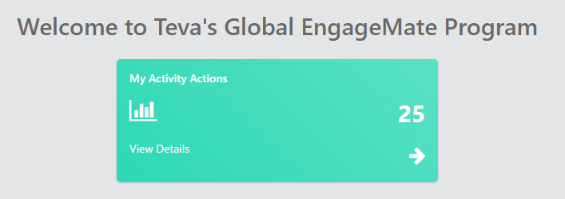
EngageMate – How to Review and Approve an Activity
1
Created: October 2022 v1

Slide 3
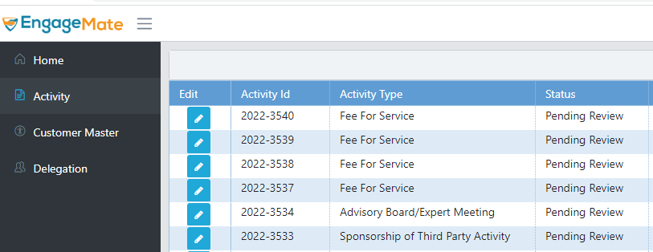
EngageMate – Select your Activity to review
2
Created: October 2022 v1

Slide 4
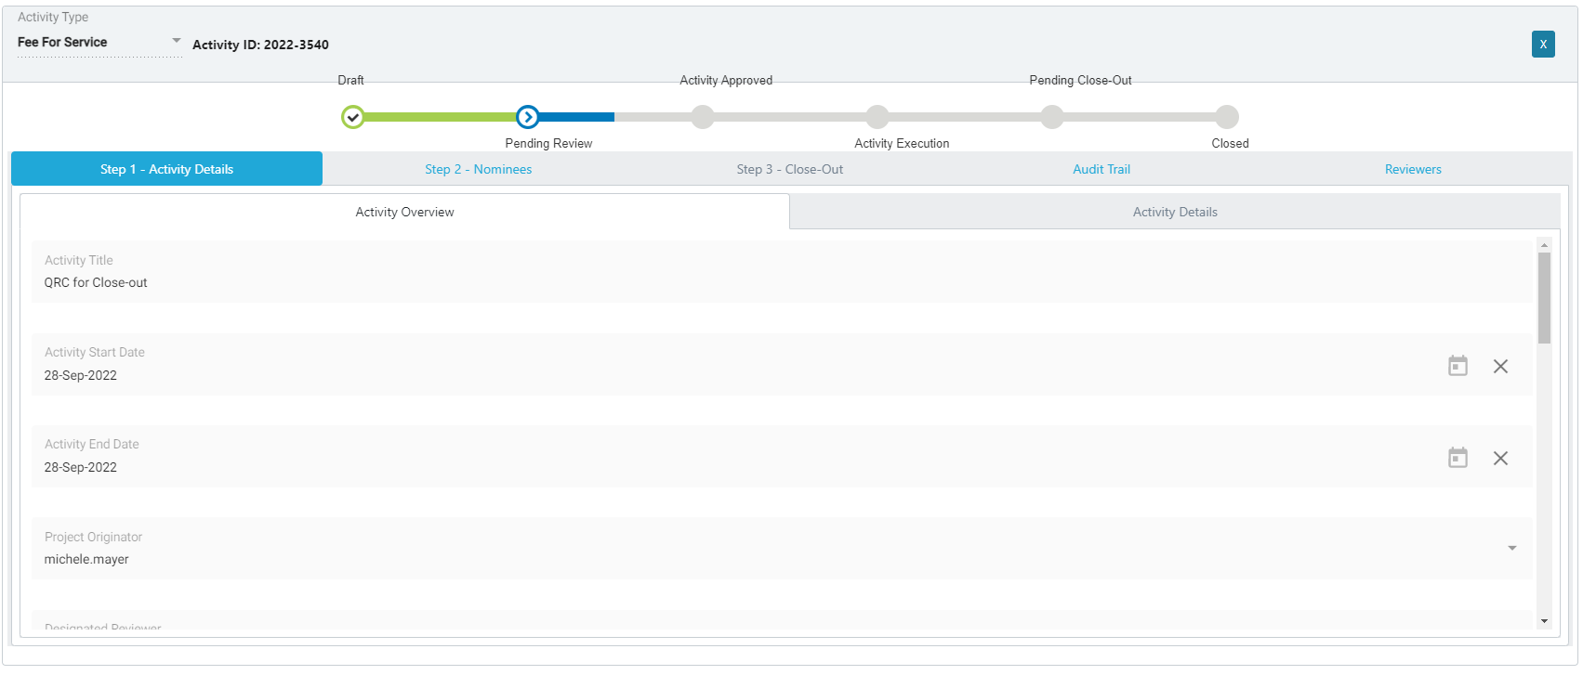
EngageMate – Start with Step 1 tab & review all fields in Overview & Detail tabs
3
4
TIP: As a Reviewer it’s you’re responsibility to ensure submission is Accurate and Complete. Thoroughly review the submission before you select approve.
Created: October 2022 v1

Slide 5
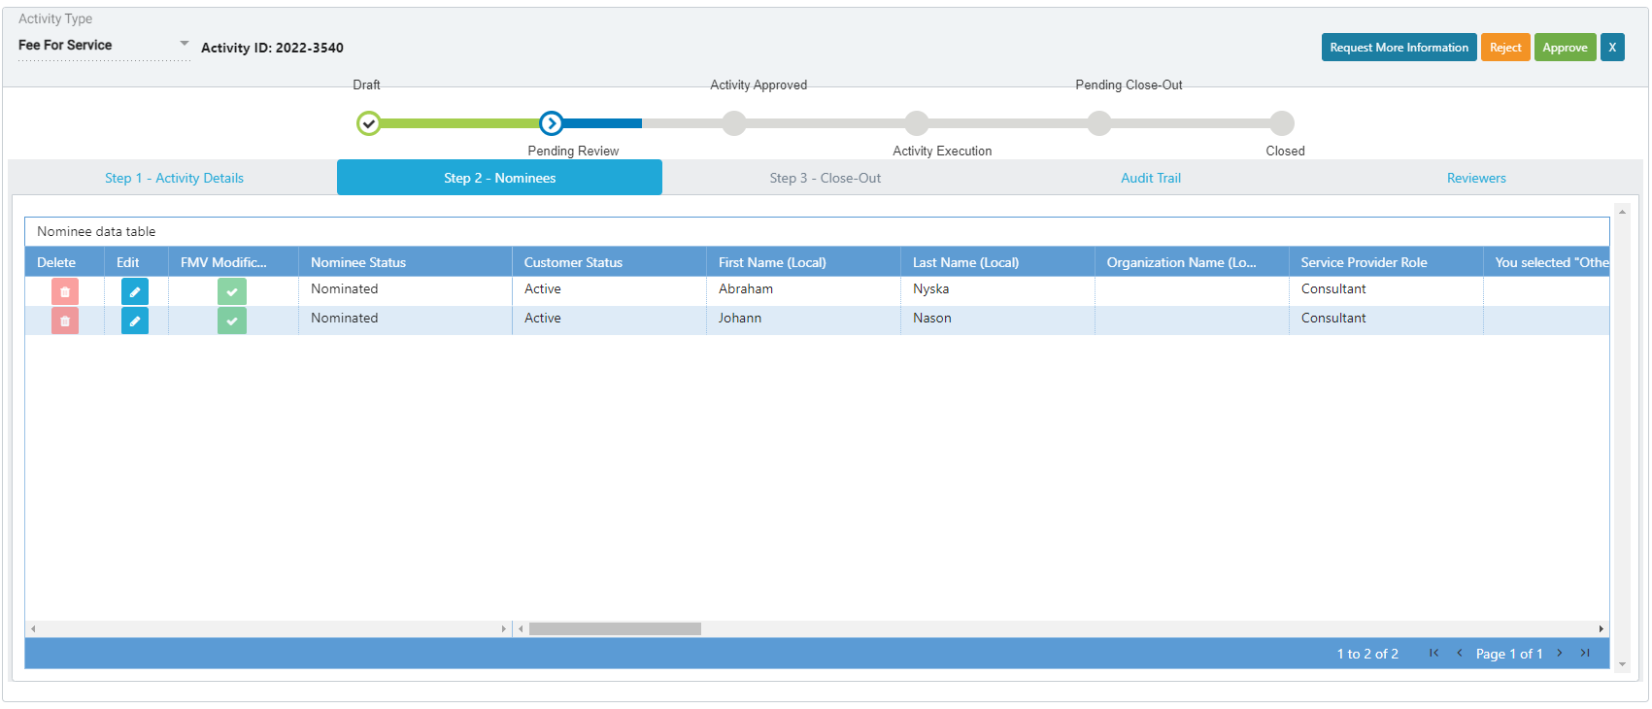
EngageMate – Review all of the Nominees – Step 2 - Nominees
5
6
TIP: As a Reviewer it’s you’re responsibility to ensure submission is Accurate and Complete. Thoroughly review the submission before you select approve.
Created: October 2022 v1

Slide 6
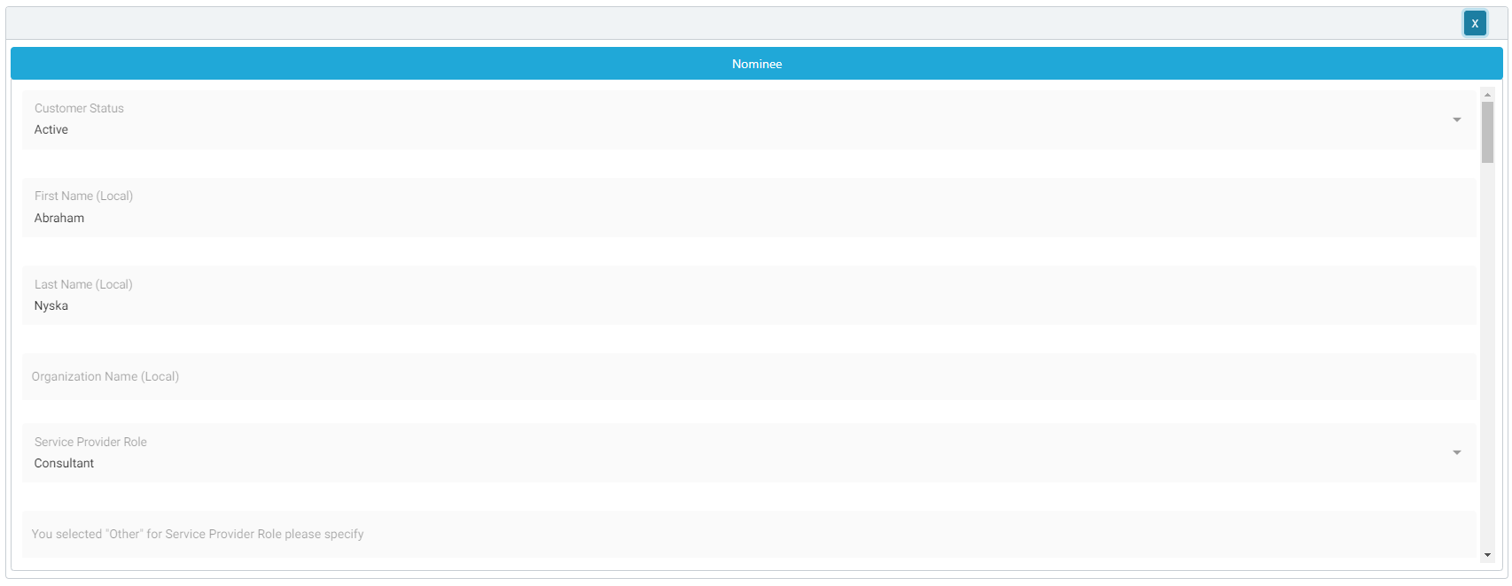
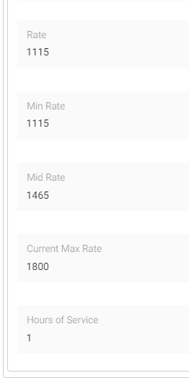
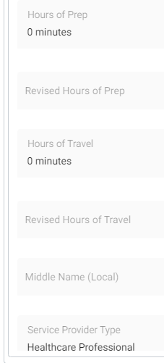
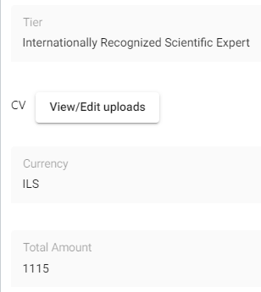
EngageMate – Review all data entered for each Nominee
8
7
TIP: As a Reviewer it’s you’re responsibility to ensure submission is Accurate and Complete. Thoroughly review the submission before you select approve.
Created: October 2022 v1

Slide 7
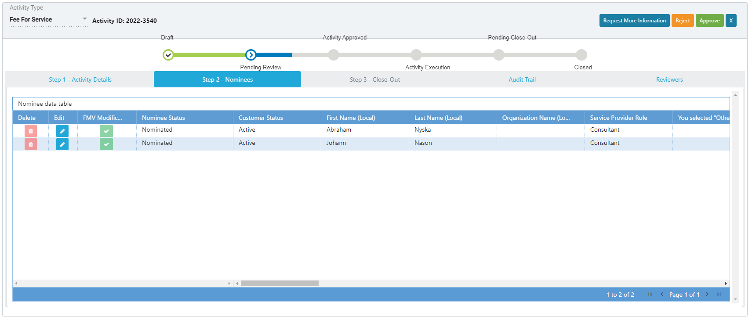
EngageMate – To Approve an Activity
9
Created: October 2022 v1

Slide 8
Congratulations!
You have approved an activity.
To view video on “How To Review & Approve an Activity”, visit to Teva Tube:
https://vod.tevapharm.com/media/EM+Reviewer+1+-+Approving+an+Activity/1_kgfqjklx
Created: October 2022 v1

Slide 9
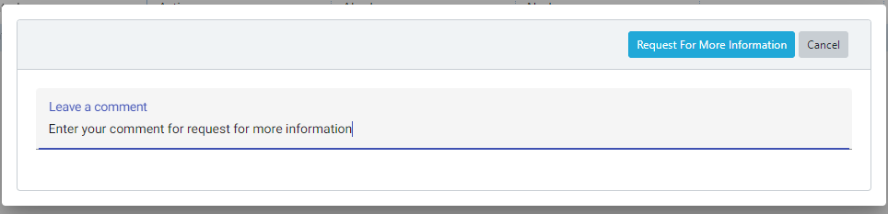
EngageMate – To Request More Information for an Activity
9
9.2
9.1
TIP: Enter detail in the comments to allow submitter’s understanding of your request
Created: October 2022 v1

Slide 10
You have now requested more information for an activity.
To view video on “How To Request More Information, as a Reviewer”, visit to Teva Tube:
https://vod.tevapharm.com/media/EM+Reviewer+2+-+Requesting+Additional+Information/1_e2ihb3uo
Created: October 2022 v1

Slide 11
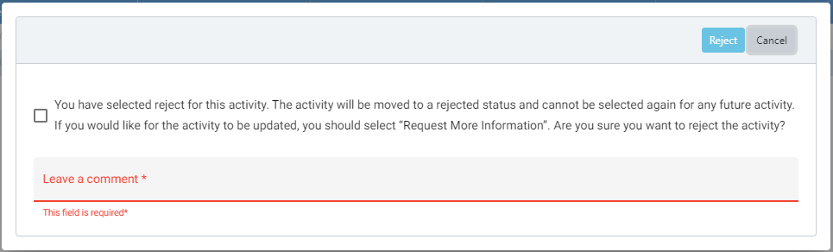
EngageMate – To Reject an Activity
9
9.3
9.1
9.2
Created: October 2022 v1

Slide 12
You have now rejected an activity.
To view video on “How To Reject an Activity, as a Reviewer”, visit to Teva Tube:
https://vod.tevapharm.com/media/EM+Reviewer+3+-+Reject+an+Activity/1_7que8k81
Created: October 2022 v1

Slide 13
EngageMate – Approve an FMV Modification (as a Designated Reviewer)
1
Created: October 2022 v1

Slide 14
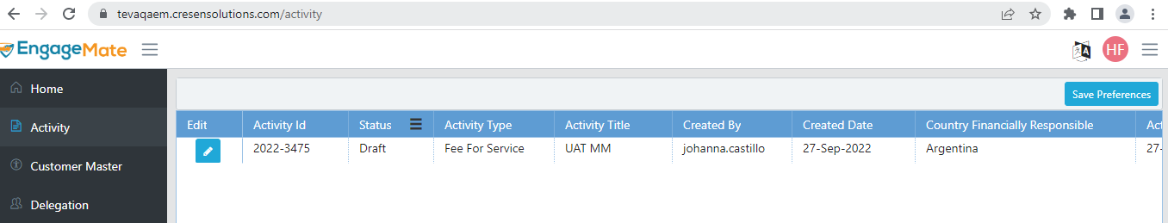
EngageMate – Locate the Activity that include a FMV Modification
2
Created: October 2022 v1

Slide 15
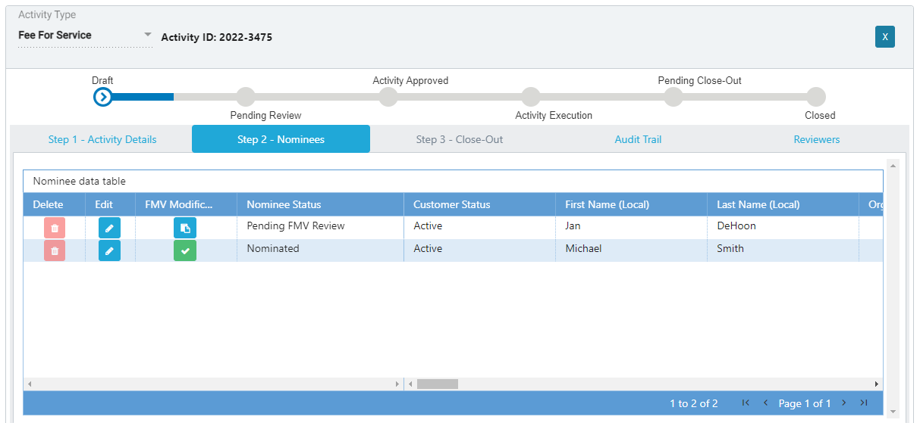
EngageMate –Open the FMV Modification (as a Designated Reviewer)
3
4
Created: October 2022 v1

Slide 16
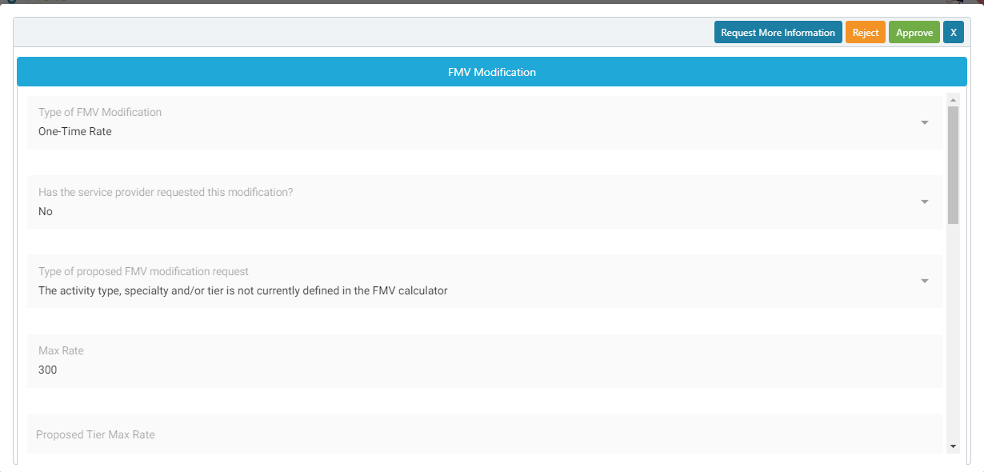
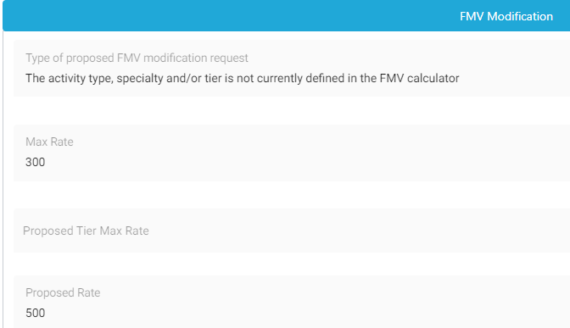

EngageMate – Review all information entered
5
6
7
This is why I am submitting this request
Created: October 2022 v1

Slide 17
EngageMate – Select your decision (as the Designated Reviewer)
8
Created: October 2022 v1

Slide 18
You have now reviewed an FMV Modification, as a Designated Reviewer.
Created: October 2022 v1

Slide 19
EngageMate – Certify and Close an Activity (as a Project Originator)
1
Created: October 2022 v1

Slide 20
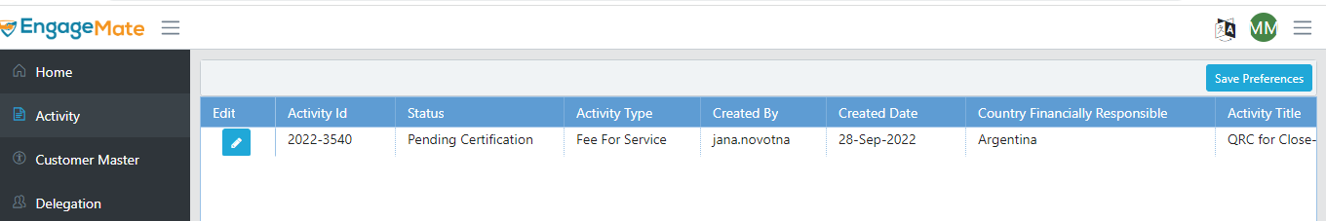
EngageMate – Locate the Activity to certify (as a Project Originator)
2
Created: October 2022 v1

Slide 21
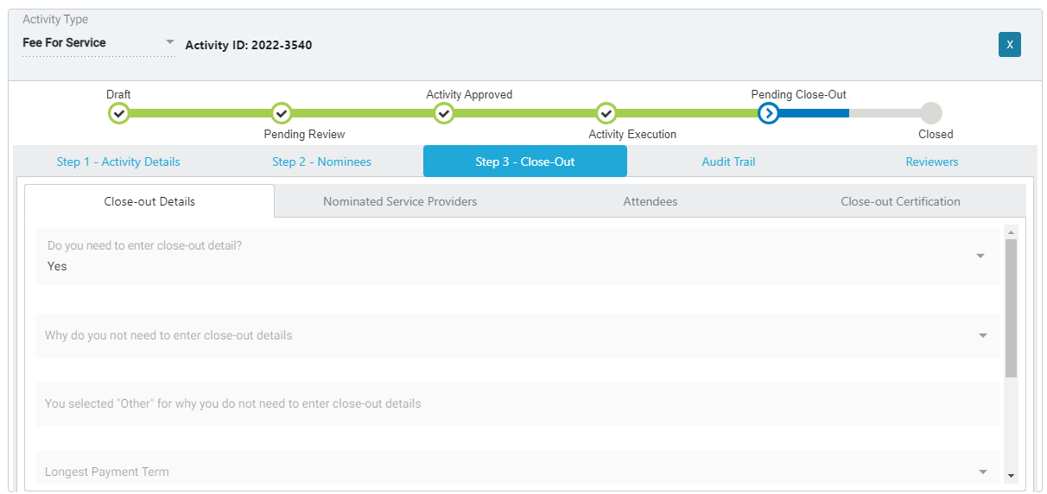
EngageMate – Review each tab and information entered (as a Project Originator)
3
4
6
5
Created: October 2022 v1

Slide 22
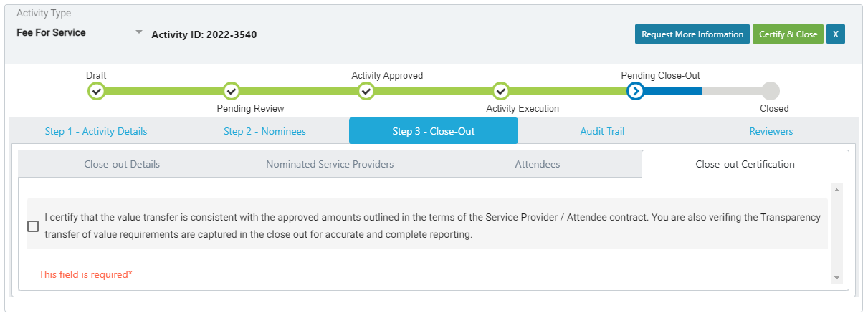
EngageMate – Certify & Close Step (as a Project Originator)
7
9
8
Created: October 2022 v1

Slide 23
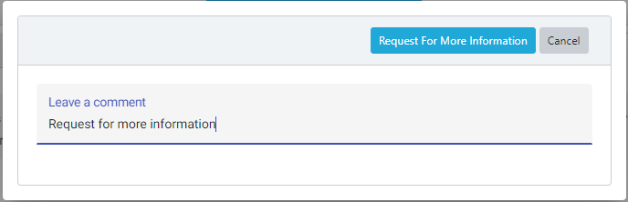
EngageMate – Request More Information (as Project Originator)
7
8
10
9
Created: October 2022 v1

Slide 24
Congratulations! You have Reviewed, Certified and Closed an activity, as a Project Originator.
To view video on “How To Certify and Close an Activity, as a Project Originator”, visit to Teva Tube:
https://vod.tevapharm.com/media/EM+Reviewer+Project+Originator+5+-+Close-out/1_0b7flolx
Created: October 2022 v1

