Slide 1


Medical Tier Reviewer
EngageMate QRC Series
CONFIDENTIAL-FOR INTERNAL USE ONLY
Notes:
Welcome to live training for EngageMate the HIP system replacement.

Slide 2

Medical Tier Reviewer
How To Review a New Service Provider; Approve, Reject or Request More Information
How to Review a Tier Change; Approve, Reject or Request More Information
Add additional Reviewers
Upload Documents (not shown)

Slide 3
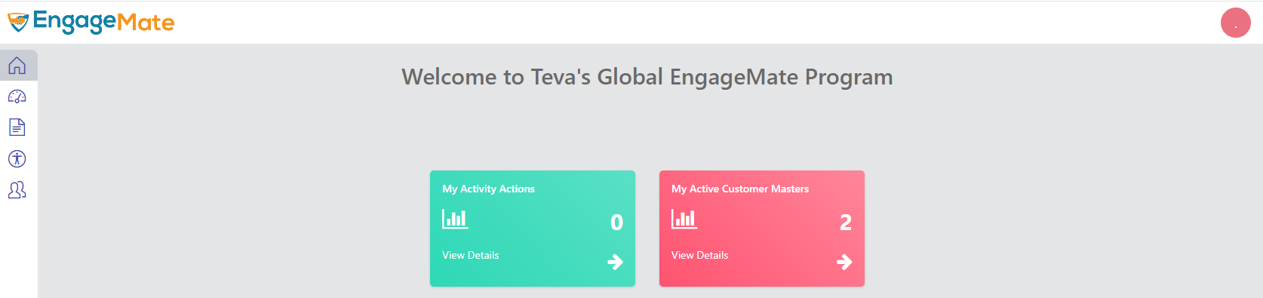
EngageMate – How to Review and Approve - New Service Provider
1

Slide 4
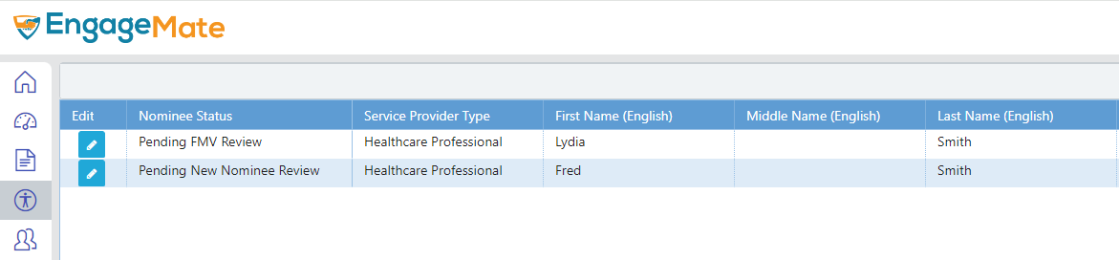
EngageMate – Select the Service Provider to review
2

Slide 5
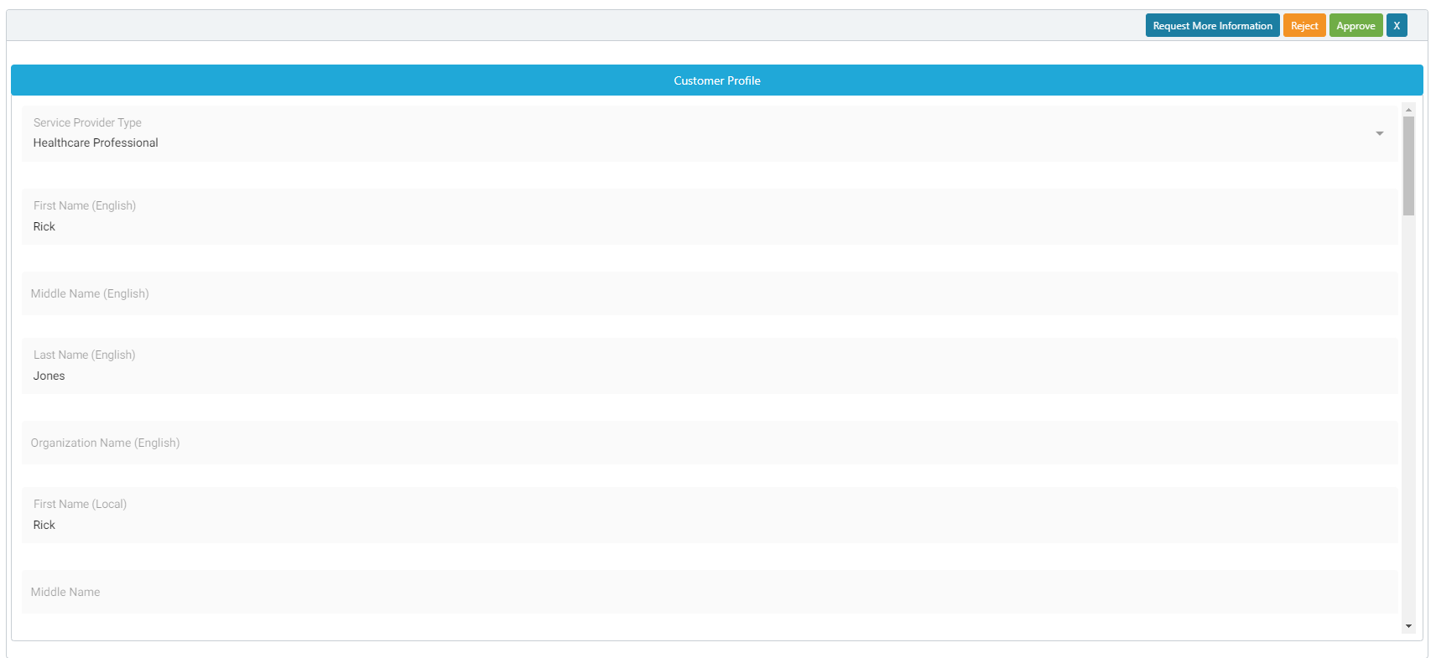
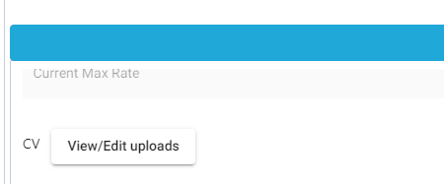
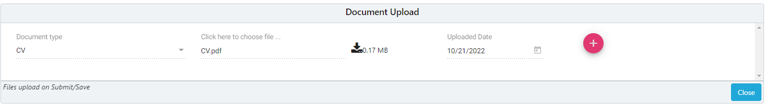
EngageMate – Review all Information & Review the CV
3
4

Slide 6
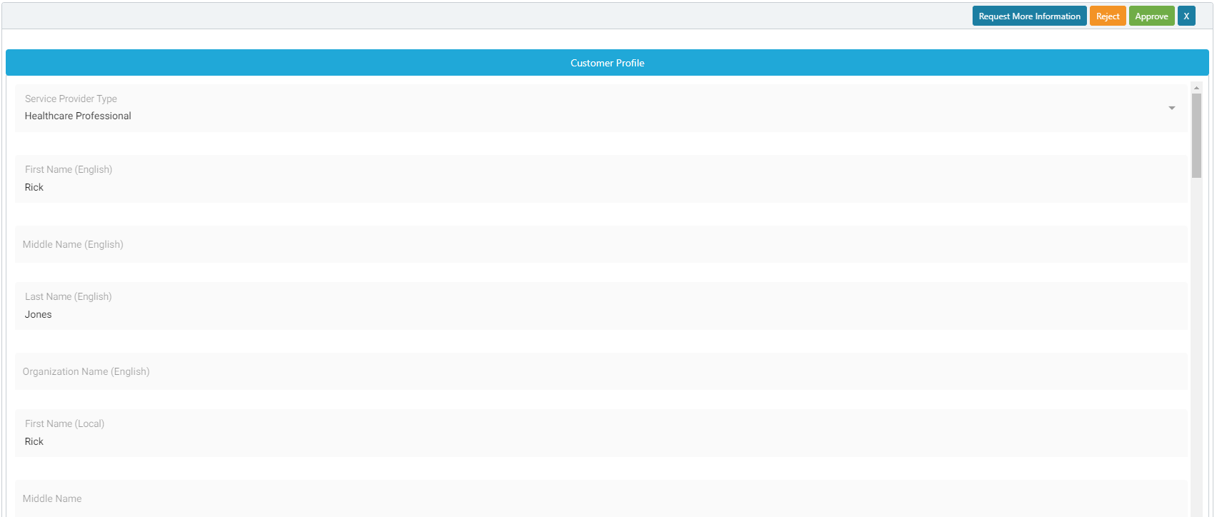
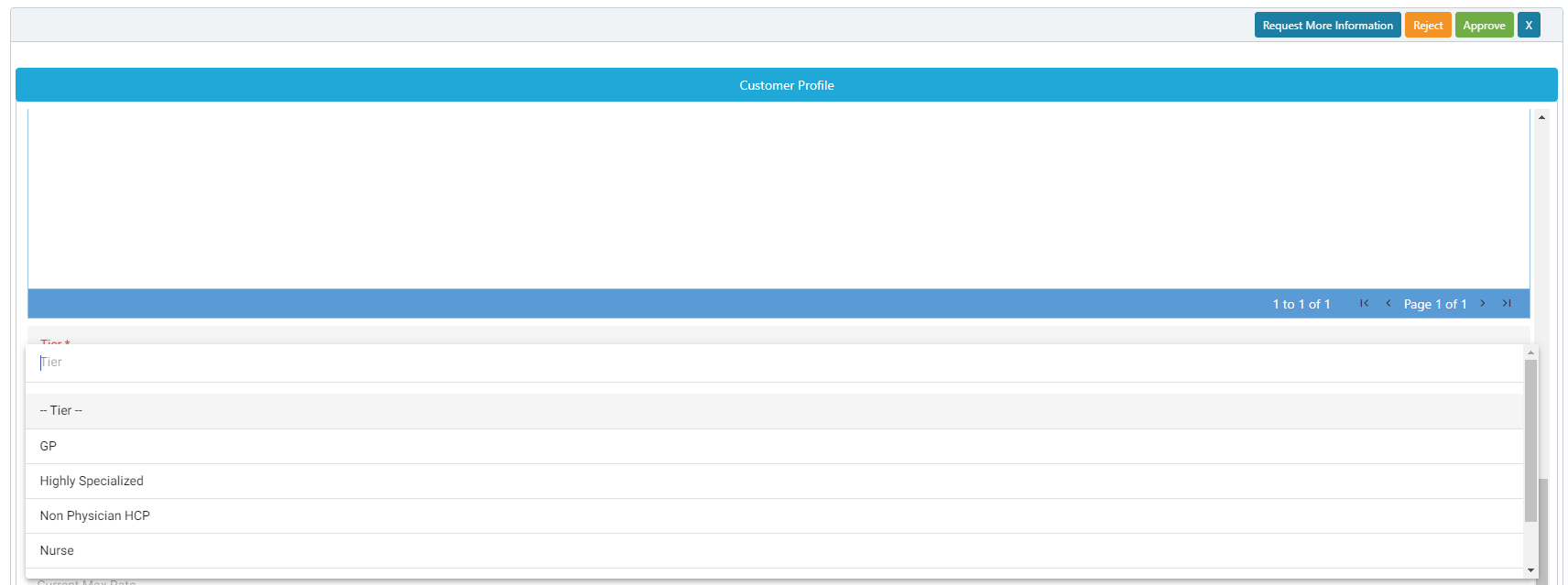
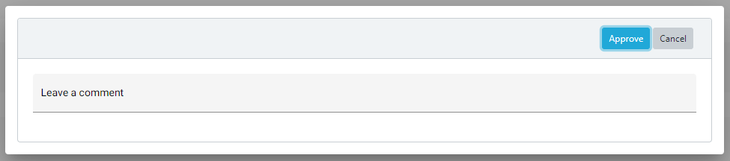
EngageMate – After your review select the Tier & Approve
6
5
8
7

Slide 7
Congratulations!
You have tiered & approved a new service provider!

Slide 8
EngageMate – How to Review and Request More Information - New Service Provider
1

Slide 9
EngageMate – Select the Service Provider to review
2

Slide 10
EngageMate – Review all Information & Review the CV
3
4

Slide 11
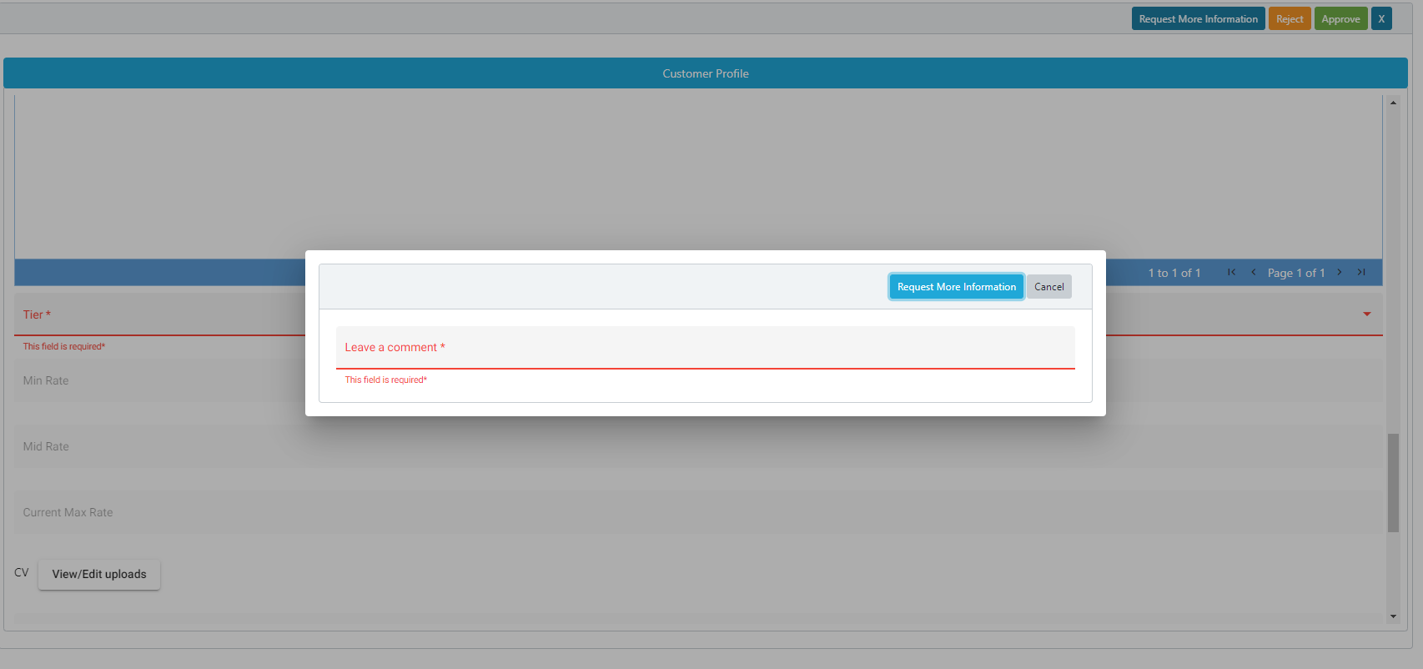
EngageMate – To Request More Information for an Activity
5
7
6
TIP: Enter detailed comments to allow submitter’s understanding of your request

Slide 12
Congratulations!
You have now requested more information for a new service provider.

Slide 13
EngageMate – How to Review and Reject - New Service Provider
1

Slide 14
EngageMate – Select the Service Provider to review
2

Slide 15
EngageMate – Review all Information & Review the CV
3
4

Slide 16
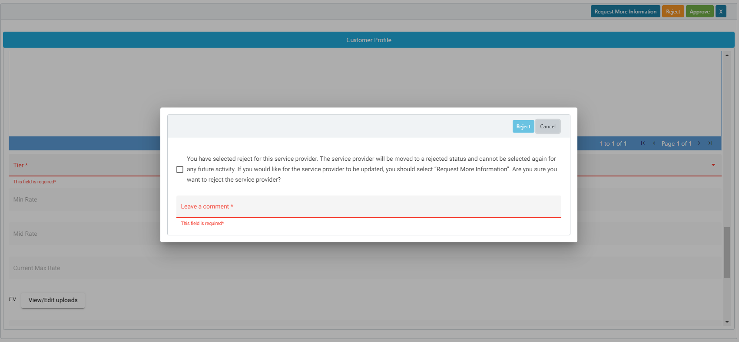
EngageMate – To Reject an Activity
5
8
6
7

Slide 17
Congratulations!
You have now rejected a new service provider.

Slide 18
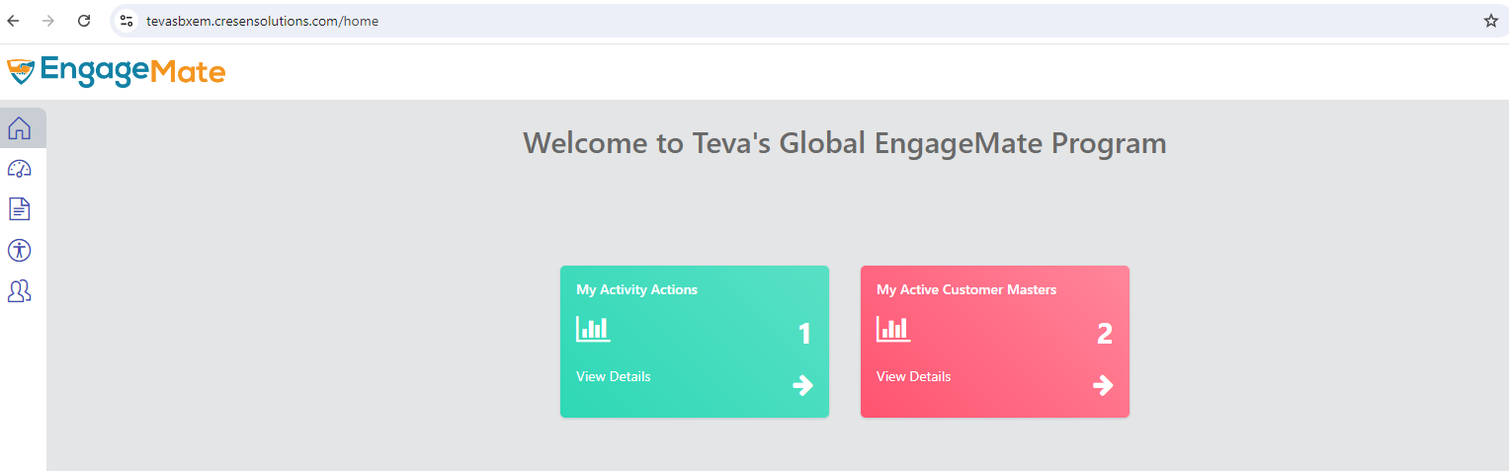
EngageMate – Approve an FMV Modification from the Customer Master
Tier Change
1

Slide 19
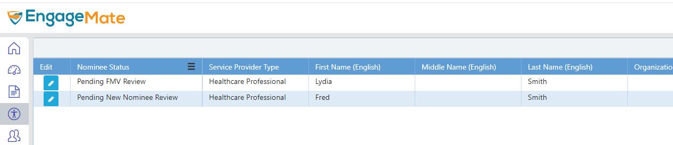
EngageMate – Locate the Service Provider with the FMV Modification
2

Slide 20
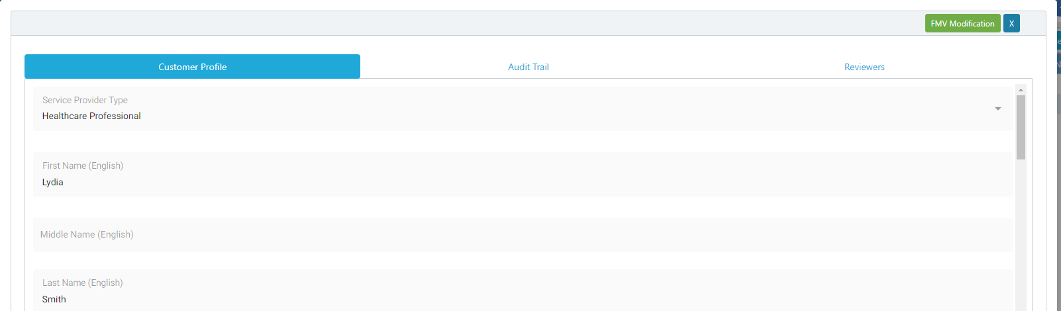
EngageMate –Open the FMV Modification
3

Slide 21
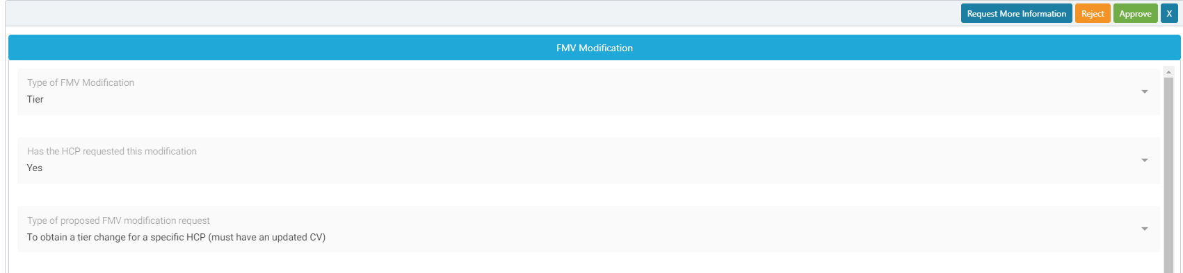
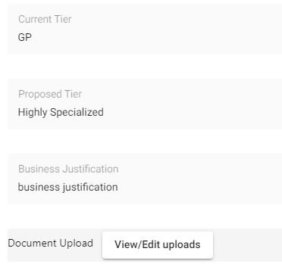
EngageMate – Review all information & render a decision
5
7
6
A Tier change does require a new CV to be uploaded by the Submitter

Slide 22
Congratulations!
You have now reviewed an FMV Modification from the Customer Master.

Slide 23
EngageMate – Approve an FMV Modification from an Activity
Tier Change
1

Slide 24
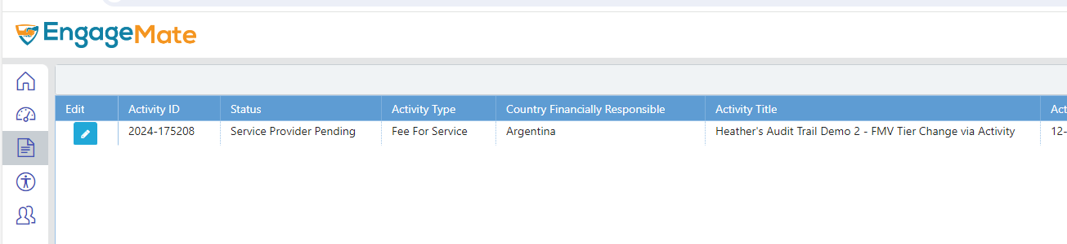
EngageMate – Locate the Activity that has the FMV Modification
2

Slide 25
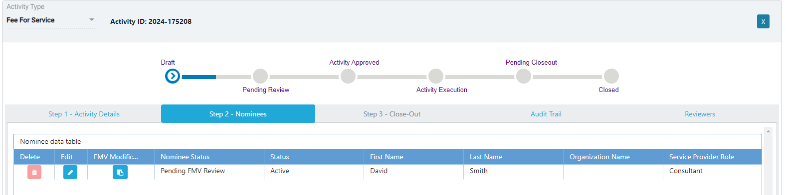
EngageMate –Open the FMV Modification
3
4

Slide 26
EngageMate – Review all information & render a decision
5
7
6
A Tier change does require a new CV to be uploaded by the Submitter

Slide 27
Congratulations!
You have now reviewed an FMV Modification from the Activity.

Slide 28
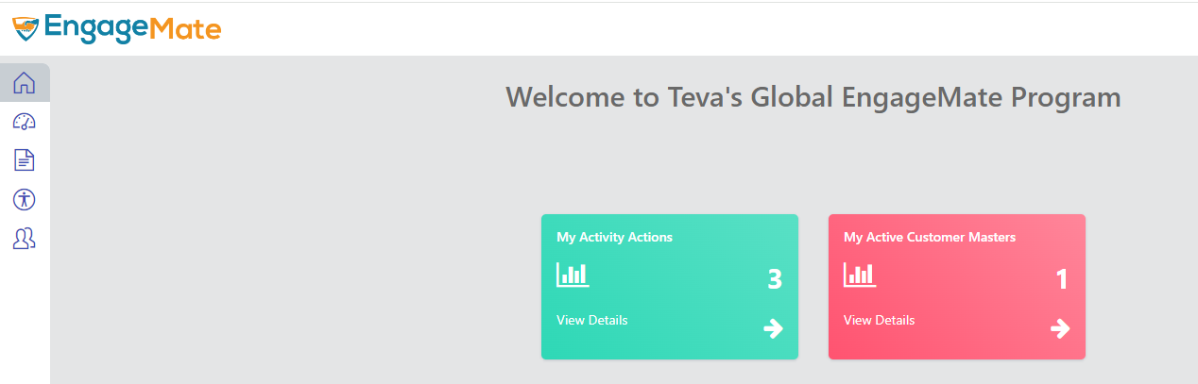
EngageMate – How to add additional reviewers
1

Slide 29
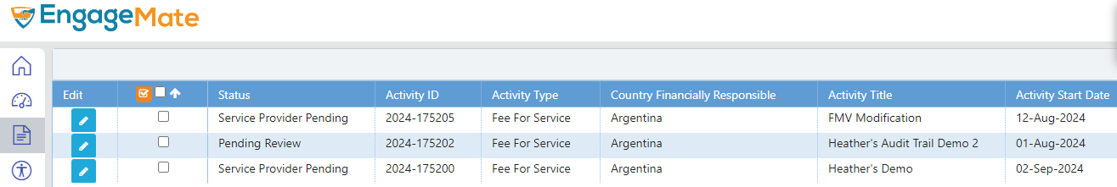
EngageMate – Select your Activity to review
2

Slide 30
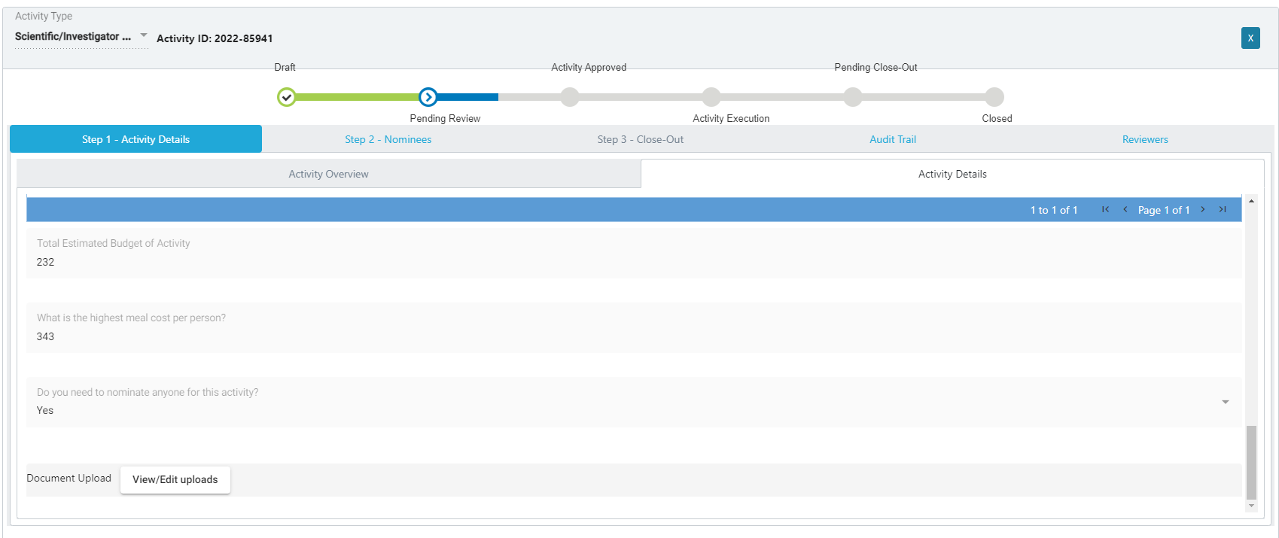
EngageMate – Complete your review of the activity
3
Note: First complete your entire review of the activity and then click the Reviewers tab

Slide 31
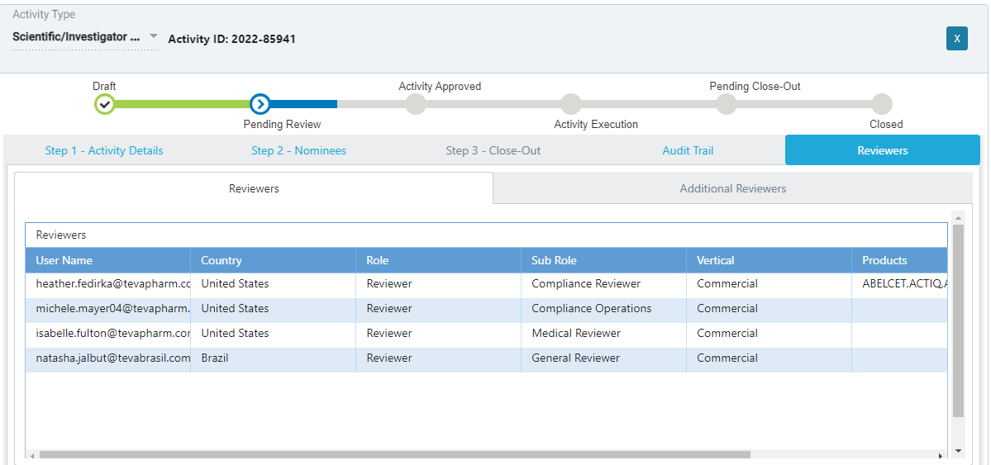
EngageMate – You want to add additional reviewers
4

Slide 32
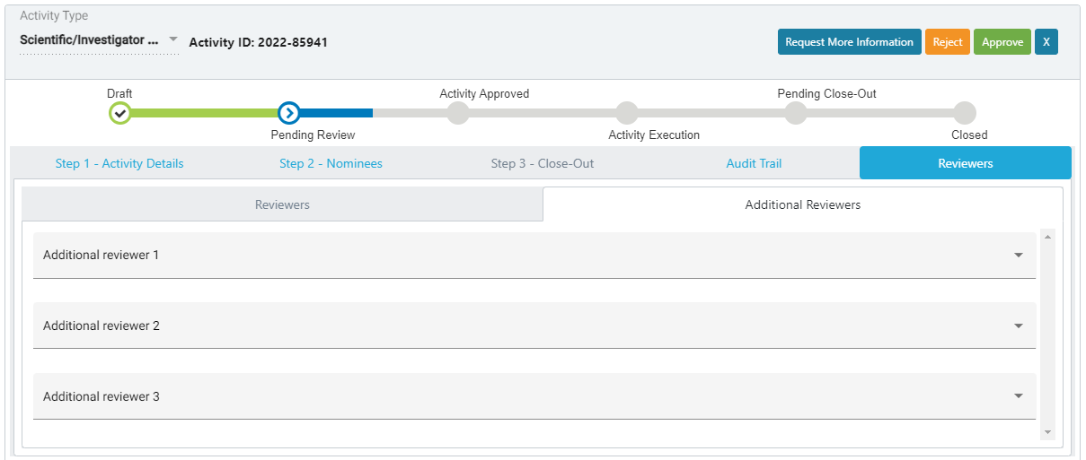
EngageMate – Select your additional reviewers & approve
5
4
Note: Once you click approve, it will route the activity to the first reviewer and will conclude with the last one.

Slide 33
You have added additional reviewers

