Slide 1


Medical Tier Reviewer
EngageMate QRC Series
CONFIDENTIAL-FOR INTERNAL USE ONLY
Created: October 2022 v1
Notes:
Welcome to live training for EngageMate the HIP system replacement.

Slide 2

Medical Tier Reviewer
How To Review a New Service Provider; Approve, Reject or Request More Information
How to Review a Tier Change; Approve, Reject or Request More Information

Slide 3
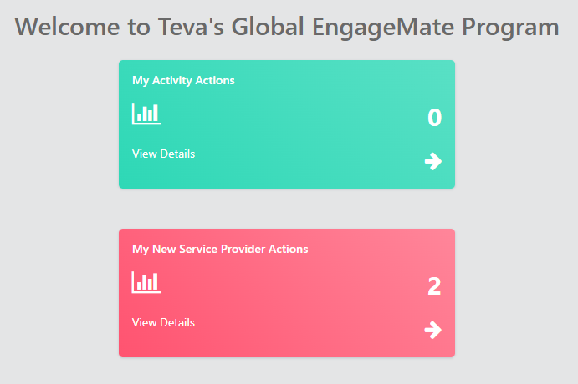
EngageMate – How to Review and Approve - New Service Provider
1
Created: October 2022 v1

Slide 4
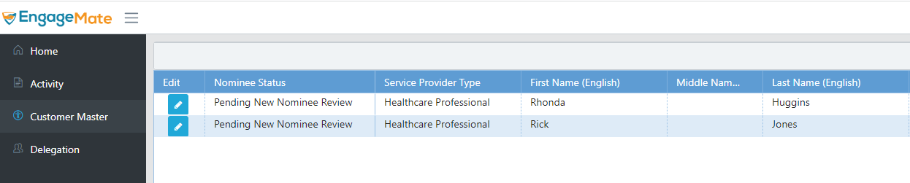
EngageMate – Select the Service Provider to review
2
Created: October 2022 v1

Slide 5
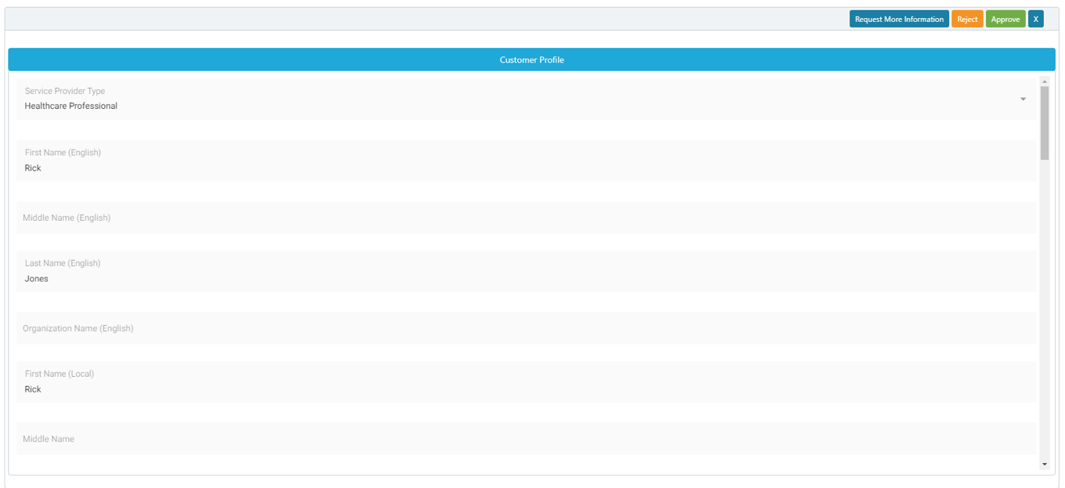
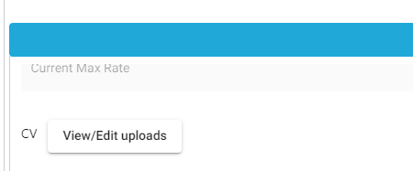
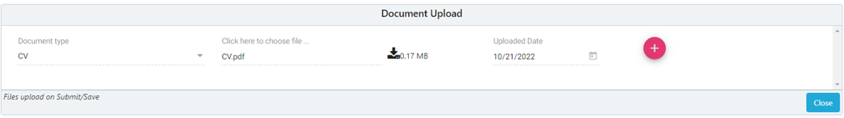
EngageMate – Review all Information & Review the CV
3
4
Created: October 2022 v1

Slide 6
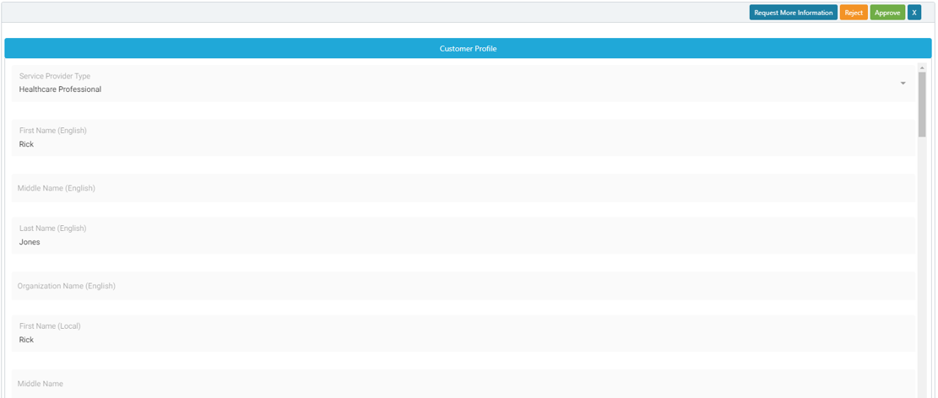
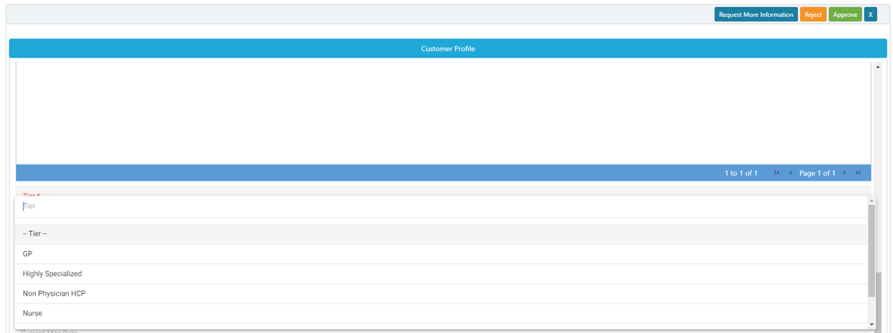
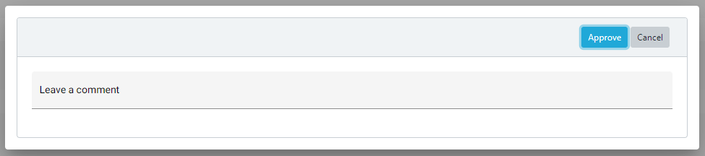
EngageMate – After your review select the Tier & Approve
6
5
8
7
Created: October 2022 v1

Slide 7
Congratulations!
You have tiered & approved a new service provider!
Created: October 2022 v1

Slide 8
EngageMate – How to Review and Request More Information - New Service Provider
1
Created: October 2022 v1

Slide 9
EngageMate – Select the Service Provider to review
2
Created: October 2022 v1

Slide 10
EngageMate – Review all Information & Review the CV
3
4
Created: October 2022 v1

Slide 11
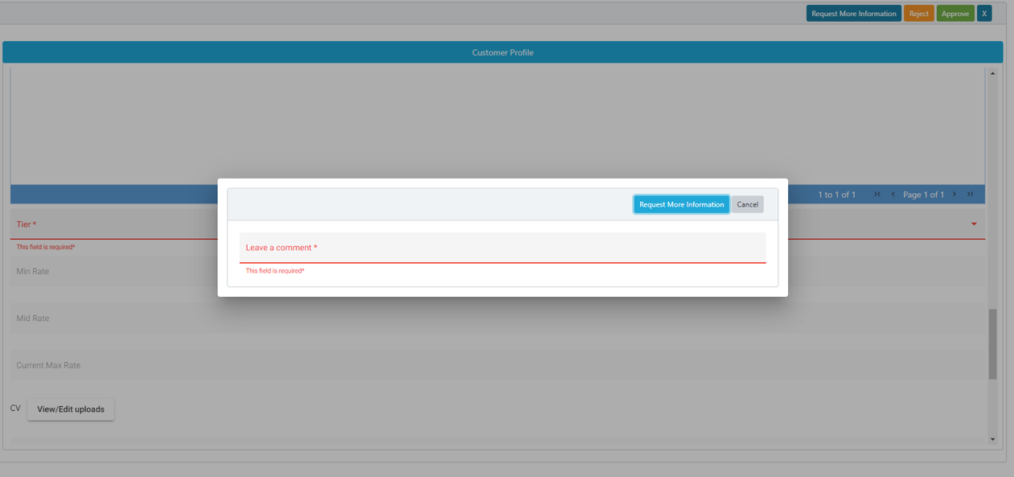
EngageMate – To Request More Information for an Activity
5
7
6
TIP: Enter detailed comments to allow submitter’s understanding of your request
Created: October 2022 v1

Slide 12
Congratulations!
You have now requested more information for a new service provider.
Created: October 2022 v1

Slide 13
EngageMate – How to Review and Reject - New Service Provider
1
Created: October 2022 v1

Slide 14
EngageMate – Select the Service Provider to review
2
Created: October 2022 v1

Slide 15
EngageMate – Review all Information & Review the CV
3
4
Created: October 2022 v1

Slide 16
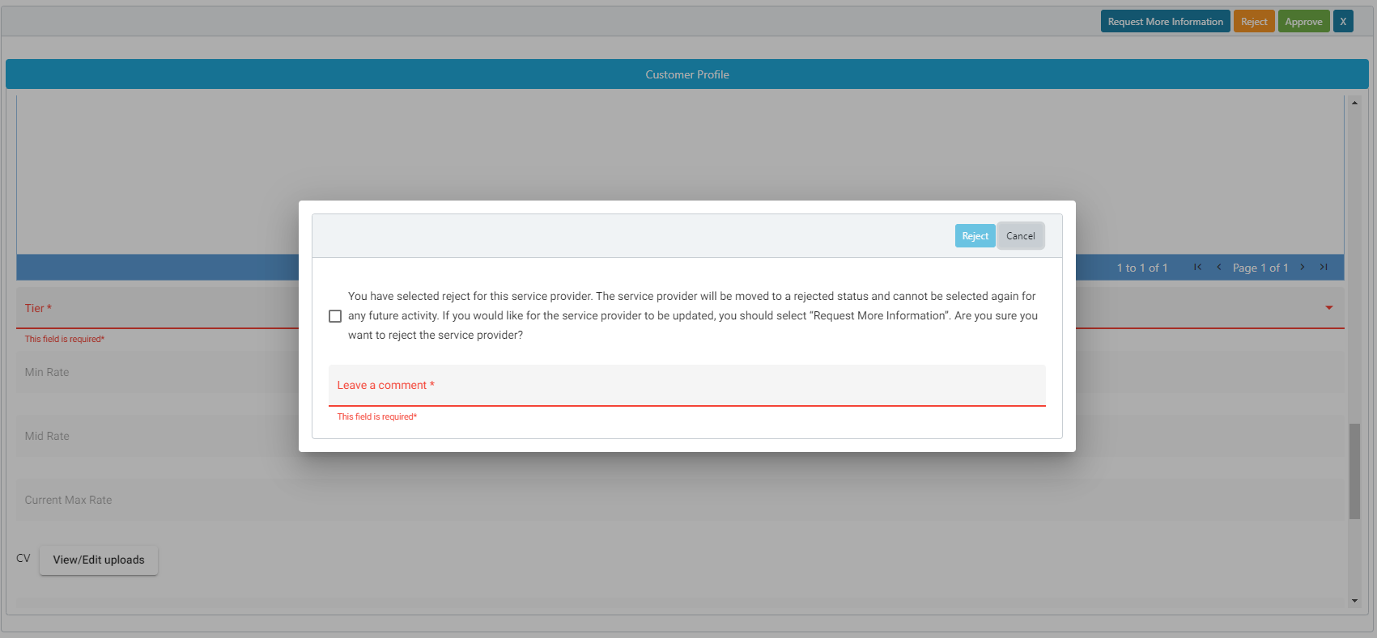
EngageMate – To Reject an Activity
5
8
6
7
Created: October 2022 v1

Slide 17
Congratulations!
You have now rejected a new service provider.
Created: October 2022 v1

Slide 18
EngageMate – Approve an FMV Modification
Tier Change
1
Created: October 2022 v1

Slide 19
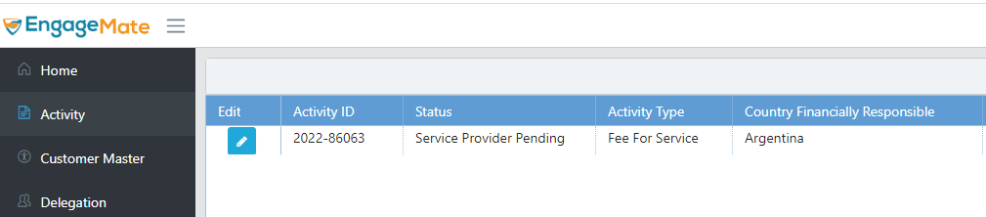
EngageMate – Locate the Activity that has the FMV Modification
2
Created: October 2022 v1

Slide 20
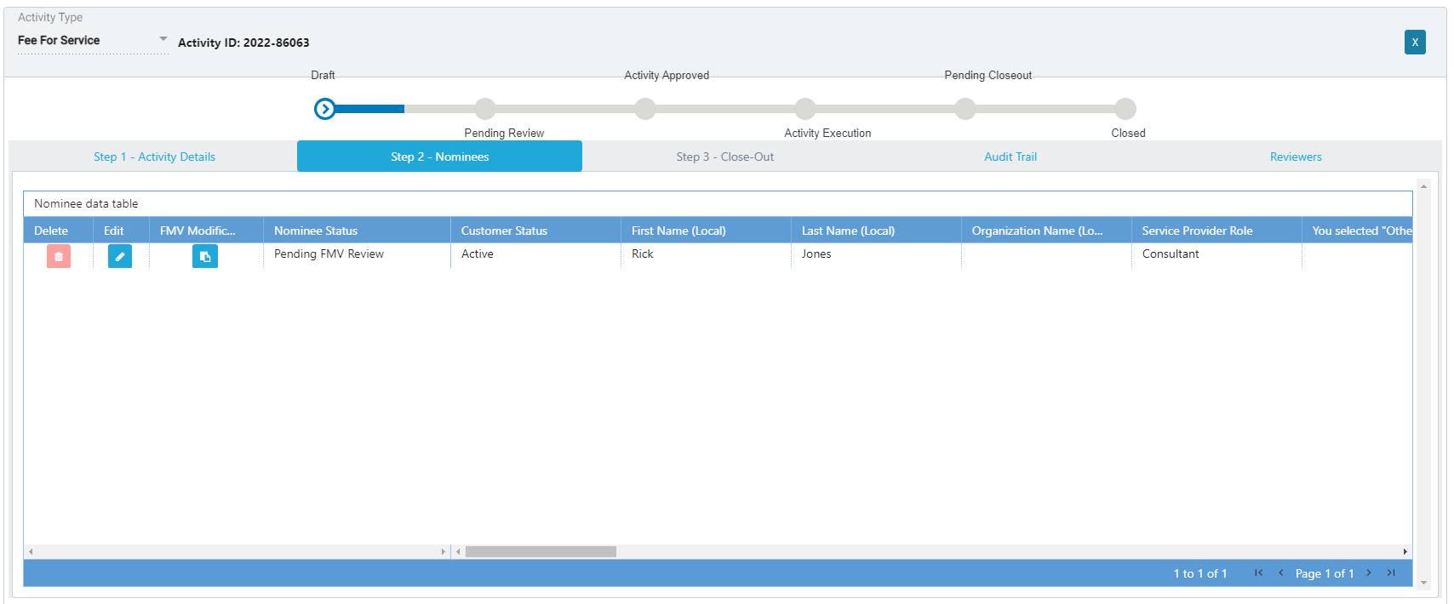
EngageMate –Open the FMV Modification
3
4
Created: October 2022 v1

Slide 21
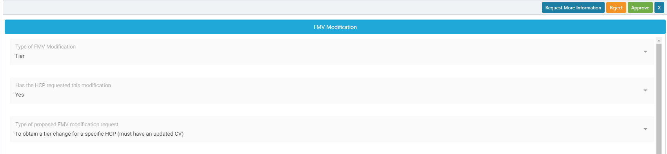
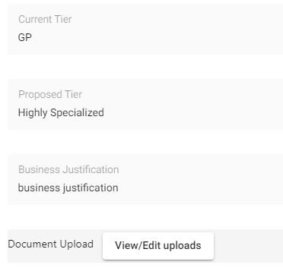
EngageMate – Review all information & render a decision
5
7
6
A Tier change does require a new CV to be uploaded by the Submitter
Created: October 2022 v1

Slide 22
Congratulations!
You have now reviewed an FMV Modification.
Created: October 2022 v1

