Slide 1


Compliance Reviewer
EngageMate QRC Series
CONFIDENTIAL-FOR INTERNAL USE ONLY
Created: October 2022 v1
Notes:
Welcome to live training for EngageMate the HIP system replacement.

Slide 2

Compliance Reviewer
How To Review An Activity to Approve, Reject or Request More Information
Upload Documents
Review an FMV Modification
Add additional Reviewers
Flag an activity to Monitor

Slide 3
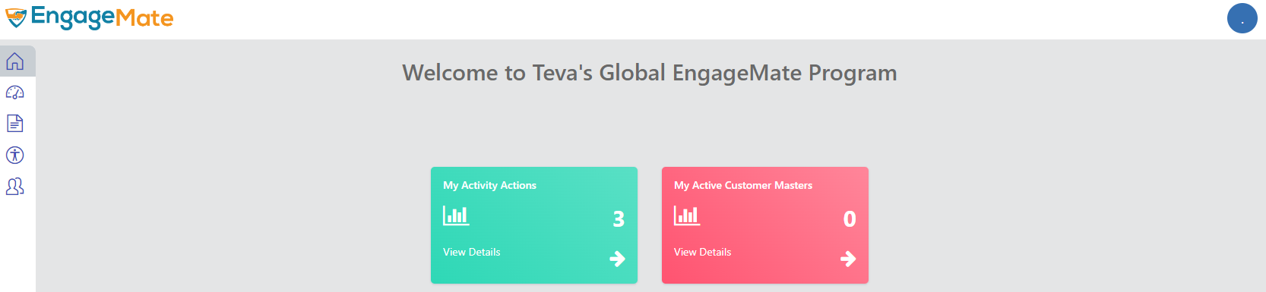
EngageMate – How to Review & Approve an Activity
1

Slide 4
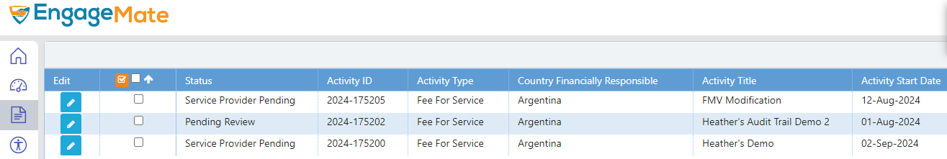
EngageMate – Select your Activity to review
2

Slide 5
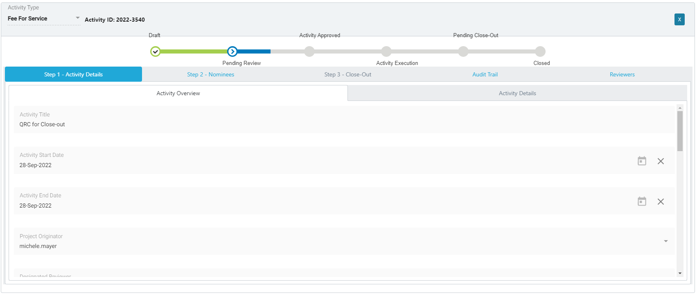
EngageMate – Start with Step 1 tab & review all fields in the tabs under step 1
3
4
TIP: As a Reviewer it is your responsibility to ensure submission is Accurate and Complete. Thoroughly review the submission before you select approve.

Slide 6
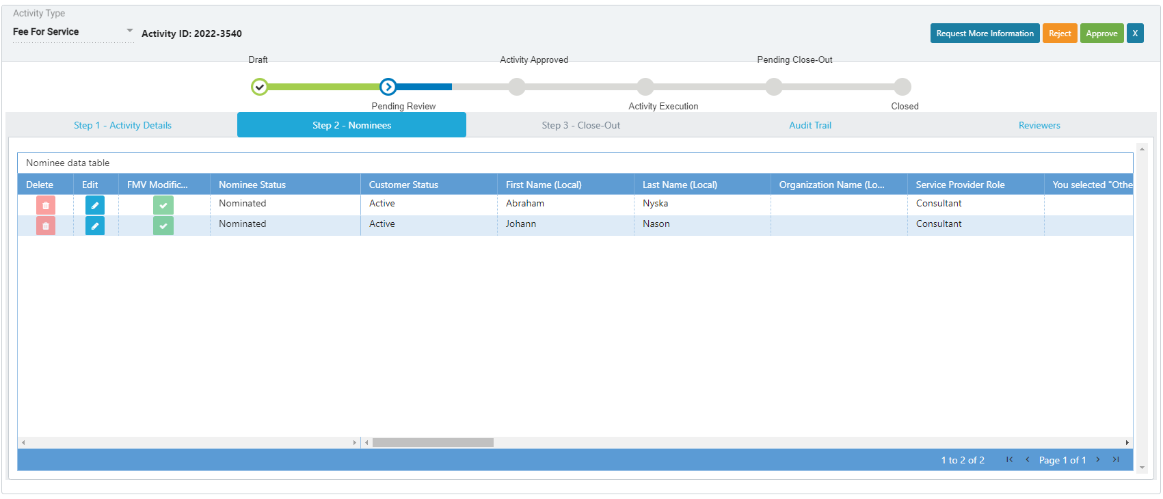
EngageMate – Review all the Nominees – Step 2 - Nominees
5
6
TIP: As a Reviewer it is your responsibility to ensure submission is Accurate and Complete. Thoroughly review the submission before you select approve.

Slide 7
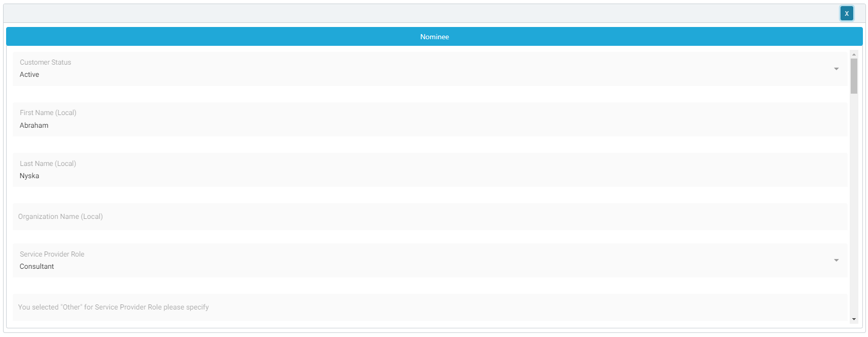
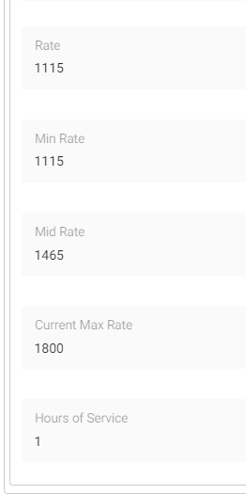
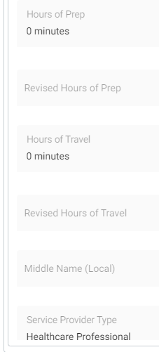
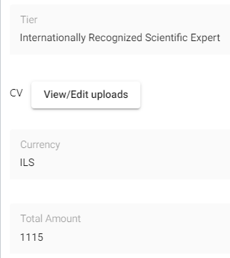
EngageMate – Review all data entered for each Nominee
8
7
TIP: As a Reviewer it is your responsibility to ensure submission is Accurate and Complete. Thoroughly review the submission before you select approve.

Slide 8
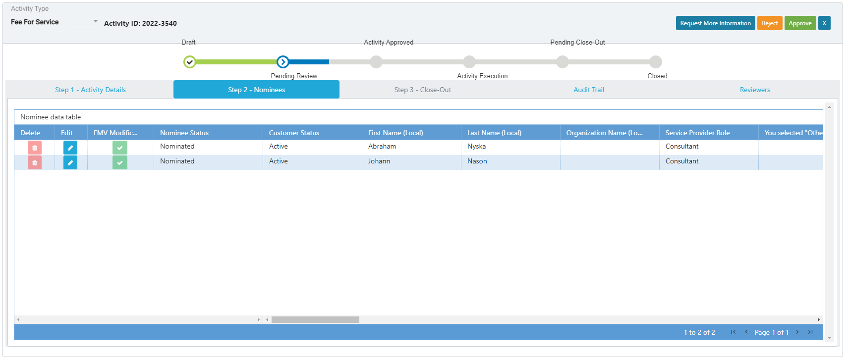
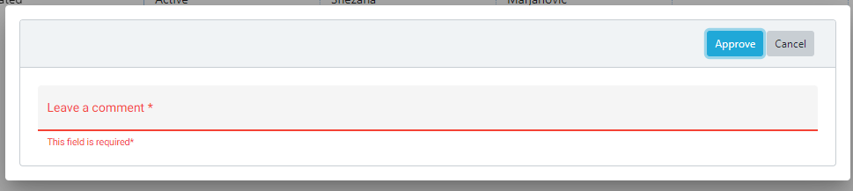
EngageMate – To Approve an Activity
9
10
Leave a comment

Slide 9
Congratulations!
You have approved an activity.
To view video on “How To Review & Approve an Activity”, visit to Teva Tube:
Created: October 2022 v1

Slide 10
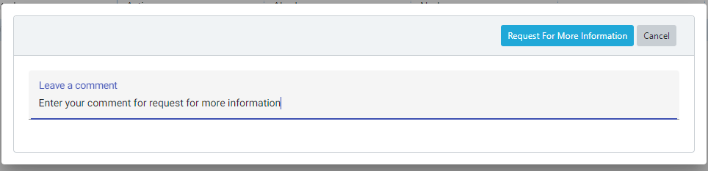
EngageMate – To Request More Information for an Activity
9
9.2
9.1
TIP: Enter detail in the comments to allow submitter’s understanding of your request

Slide 11
You have now requested more information for an activity.
To view video on “How To Request More Information, as a Reviewer”, visit to Teva Tube:
Created: October 2022 v1

Slide 12
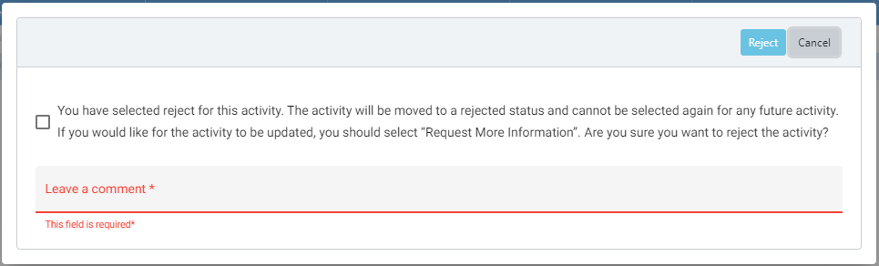
EngageMate – To Reject an Activity
9
9.3
9.1
9.2

Slide 13
You have now rejected an activity.
To view video on “How To Reject an Activity, as a Reviewer”, visit to Teva Tube:
Created: October 2022 v1

Slide 14
EngageMate – Upload Documents during your Review
1

Slide 15
EngageMate – Select your Activity to review
2

Slide 16
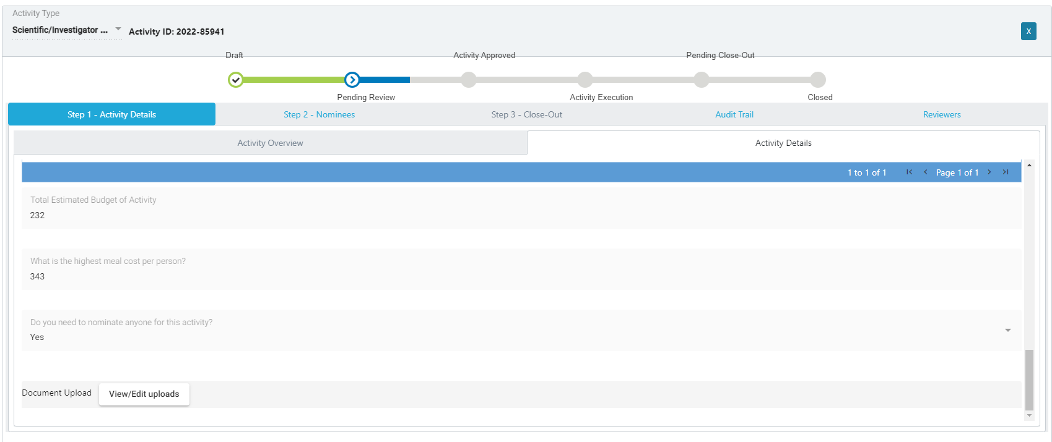
EngageMate – Upload documents during your review
3

Slide 17
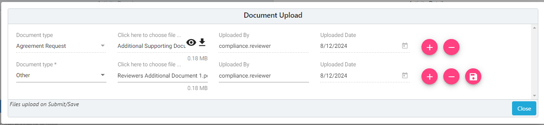
EngageMate – Upload documents during your review
4
5
7
6

Slide 18
You have successfully uploaded documents

Slide 19
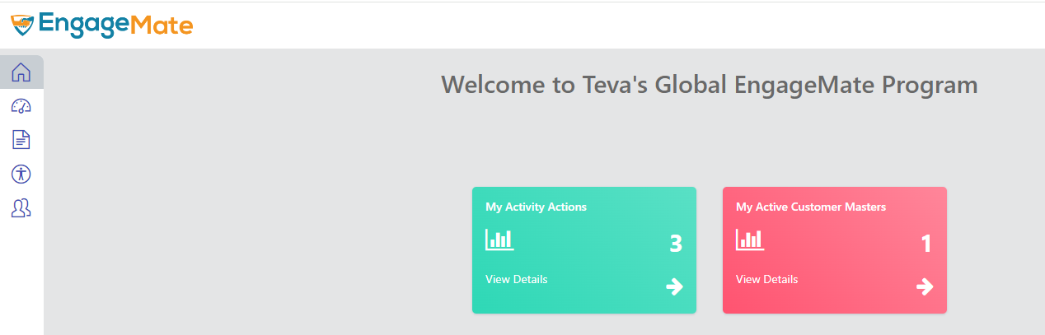
EngageMate – Approve an FMV Modification
One Time Rate Change
Permanent Rate Change
Prep Time
Travel Time
1

Slide 20
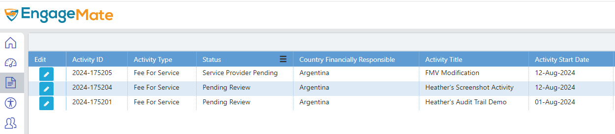
EngageMate – Locate the Activity that includes an FMV Modification
2

Slide 21
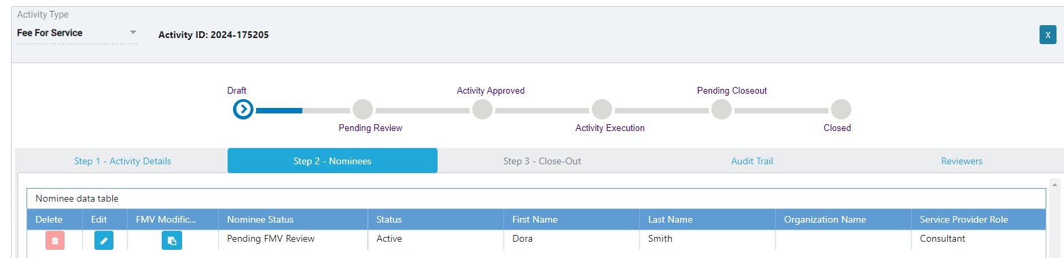
EngageMate –Open the FMV Modification
3
4

Slide 22
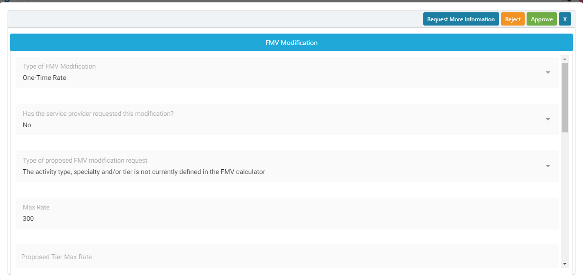
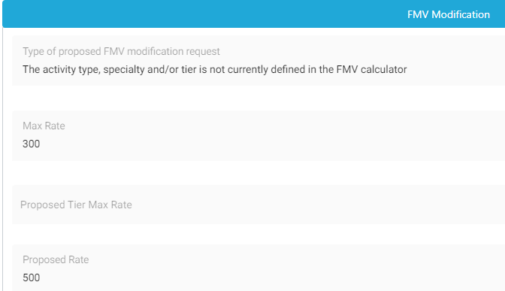

EngageMate – Review all information entered
5
6
7
This is why I am submitting this request

Slide 23
EngageMate – Select your decision
8

Slide 24
You have now reviewed an FMV Modification

Slide 25
EngageMate – How to add additional reviewers
1

Slide 26
EngageMate – Select your Activity to review
2

Slide 27
EngageMate – Complete your review of the activity
3
Note: First complete your entire review of the activity and then click the Reviewers tab

Slide 28
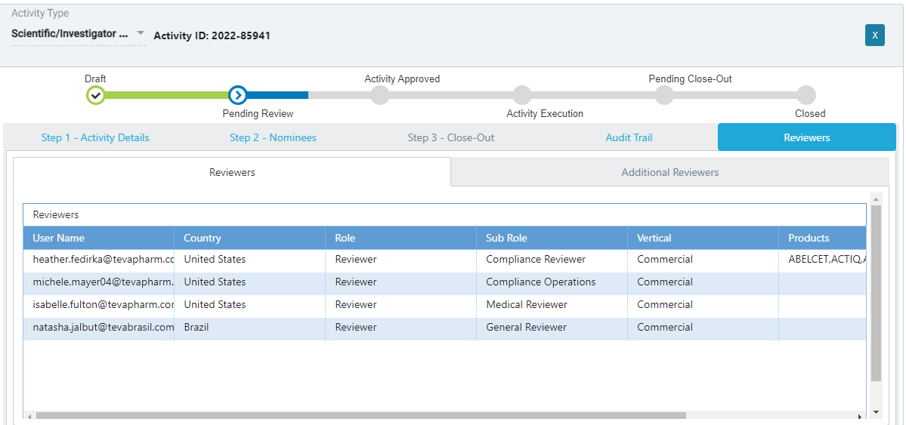
EngageMate – You want to add additional reviewers
4

Slide 29
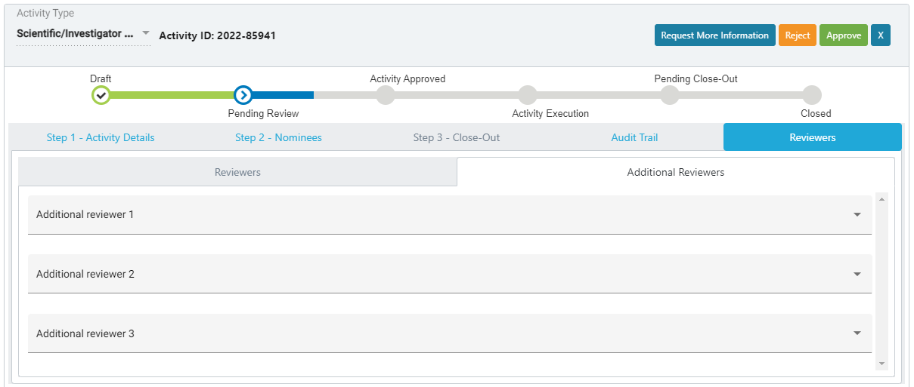
EngageMate – Select your additional reviewers & approve
5
4
Note: Once you click approve, it will route the activity to the first reviewer and will conclude with the last one.

Slide 30
You have added additional reviewers

Slide 31
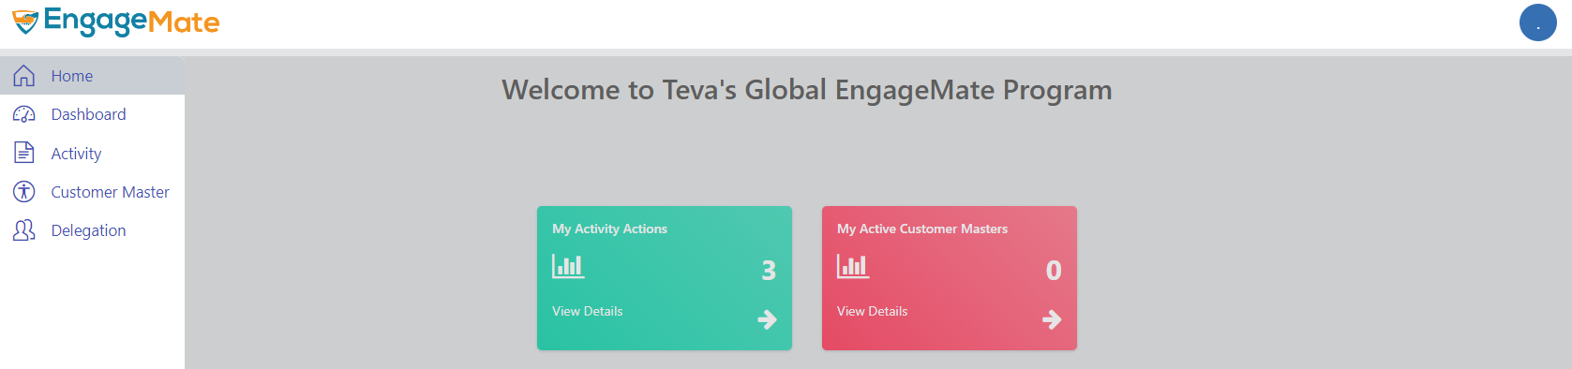
EngageMate – Flag an activity to monitor
1

Slide 32
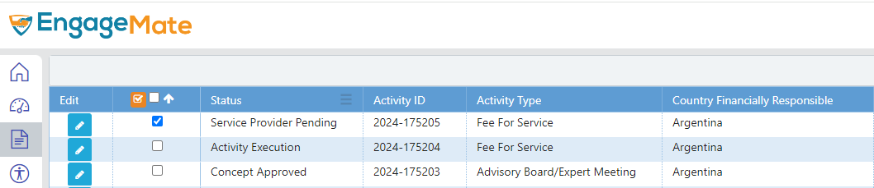

EngageMate – Flag an activity to monitor
4
3
2
Note: The same functionality as you have in MonitorMate

Slide 33
You have flagged an activity that you want to monitor

