Slide 1


Compliance Reviewer
EngageMate QRC Series
CONFIDENTIAL-FOR INTERNAL USE ONLY
Created: October 2022 v1
Notes:
Welcome to live training for EngageMate the HIP system replacement.

Slide 2

Compliance Reviewer
How To Review An Activity to Approve, Reject or Request More Information
Upload Documents
Review an FMV Modification
Add additional Reviewers
Flag an activity to Monitor

Slide 3
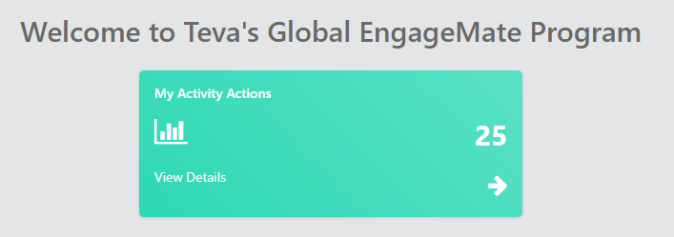
EngageMate – How to Review and Approve an Activity
1
Created: October 2022 v1

Slide 4
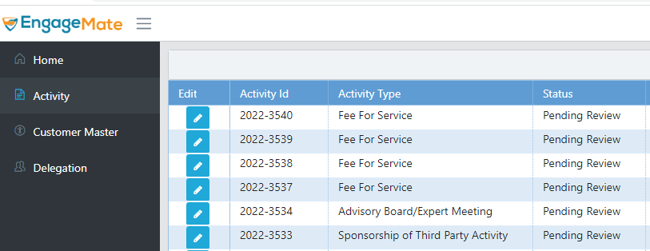
EngageMate – Select your Activity to review
2
Created: October 2022 v1

Slide 5
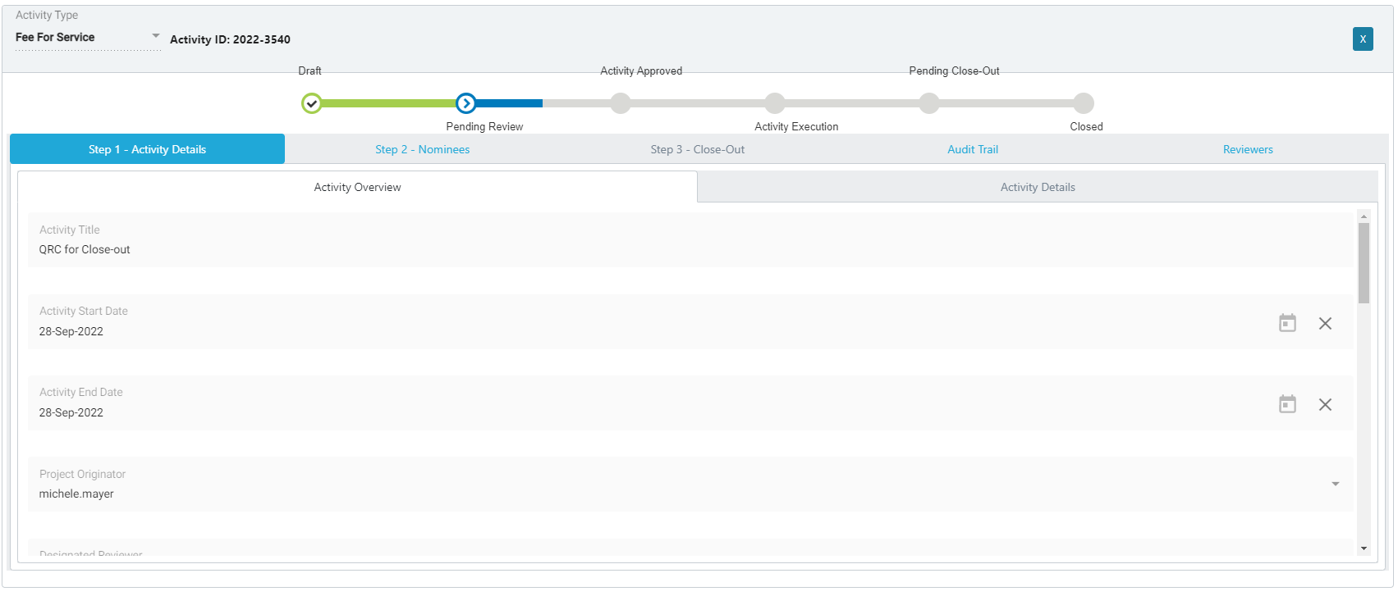
EngageMate – Start with Step 1 tab & review all fields in Overview & Detail tabs
3
4
TIP: As a Reviewer it’s your responsibility to ensure submission is Accurate and Complete. Thoroughly review the submission before you select approve.
Created: October 2022 v1

Slide 6
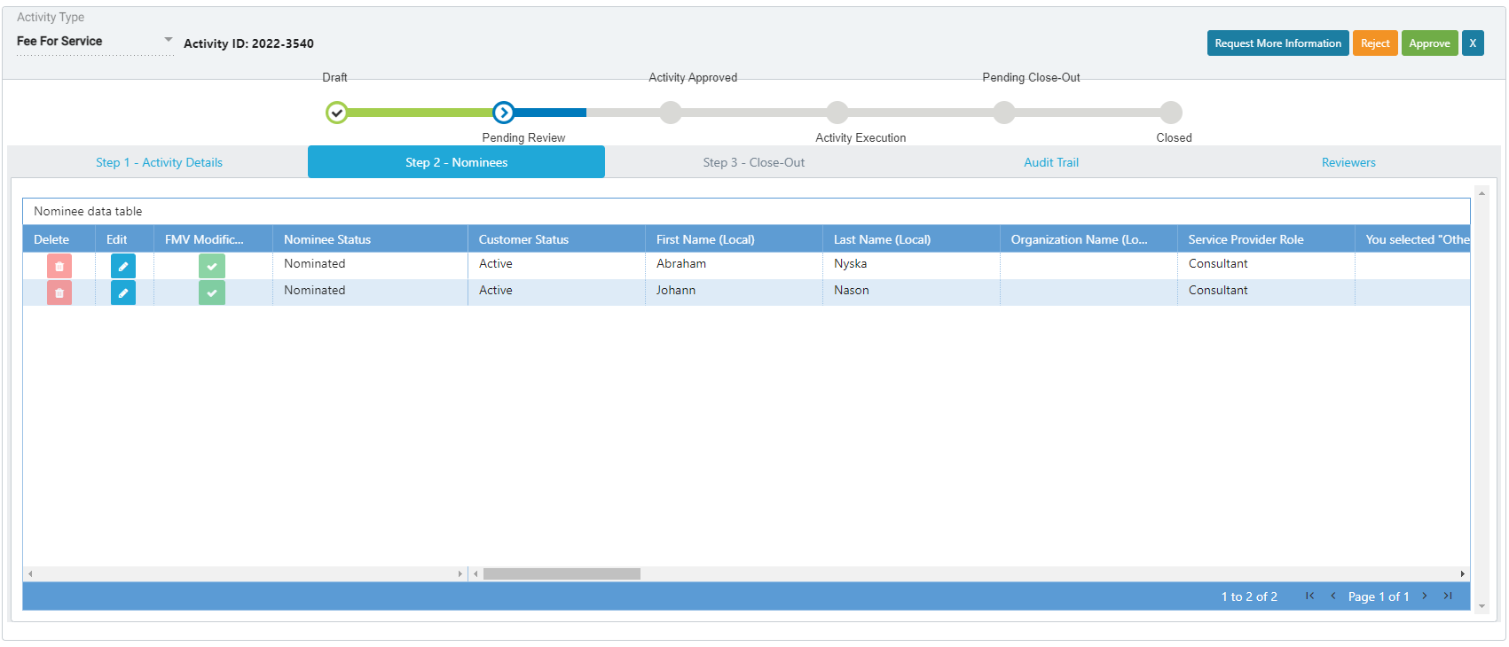
EngageMate – Review all of the Nominees – Step 2 - Nominees
5
6
TIP: As a Reviewer it’s your responsibility to ensure submission is Accurate and Complete. Thoroughly review the submission before you select approve.
Created: October 2022 v1

Slide 7
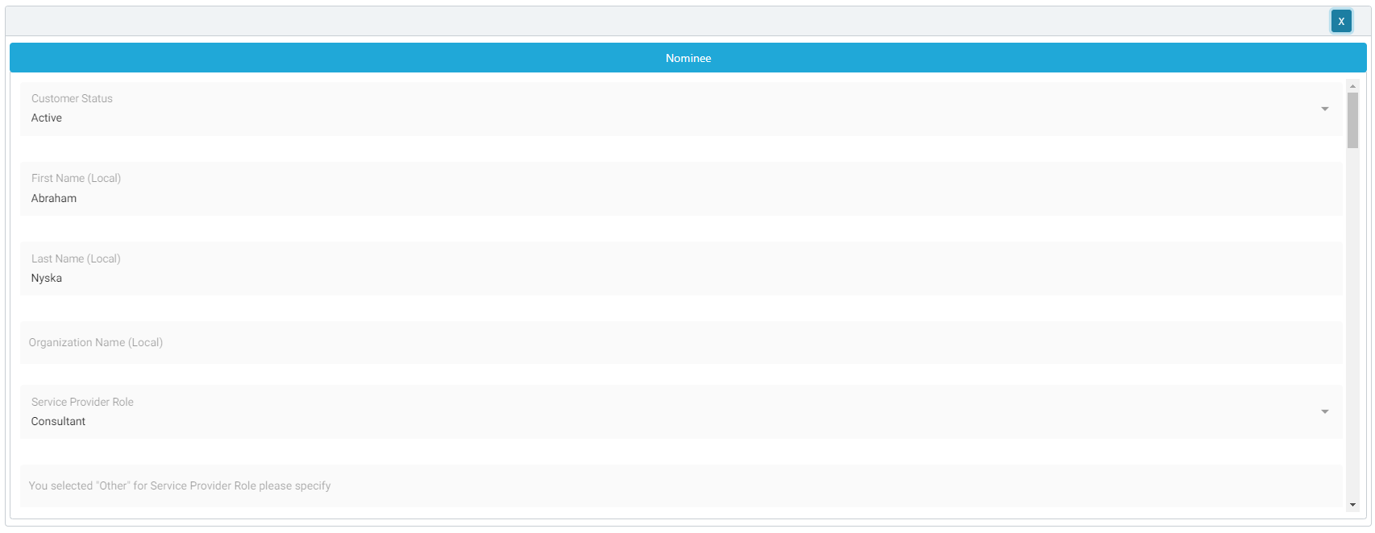
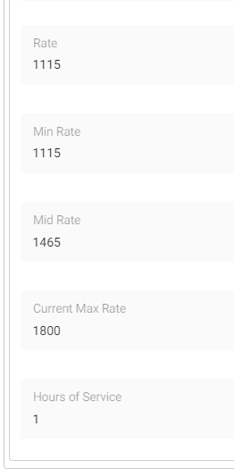
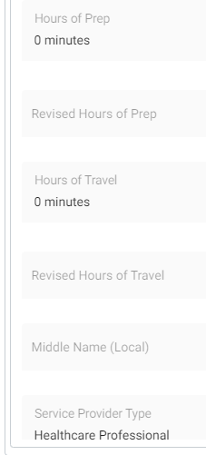
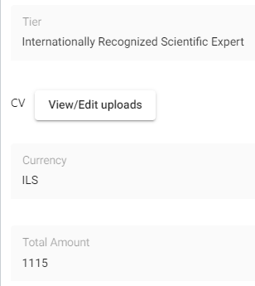
EngageMate – Review all data entered for each Nominee
8
7
TIP: As a Reviewer it’s your responsibility to ensure submission is Accurate and Complete. Thoroughly review the submission before you select approve.
Created: October 2022 v1

Slide 8
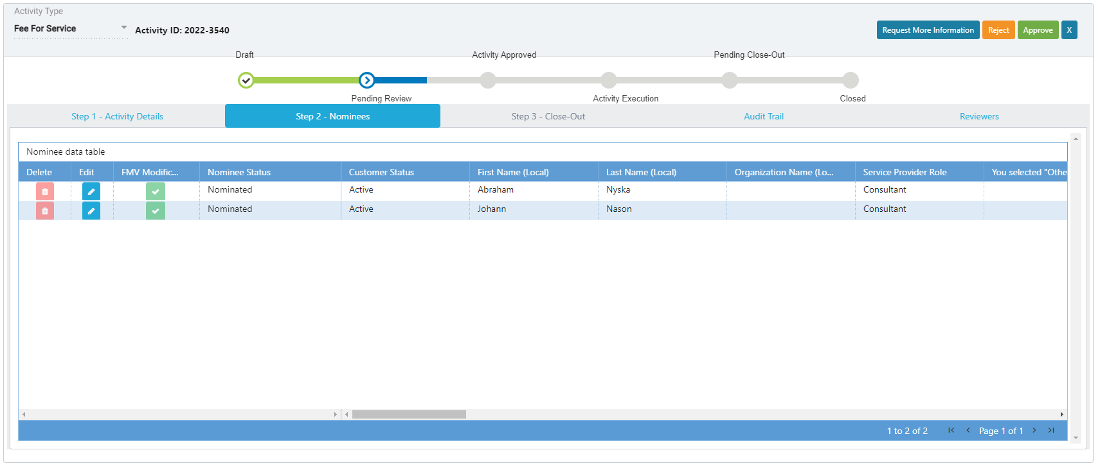
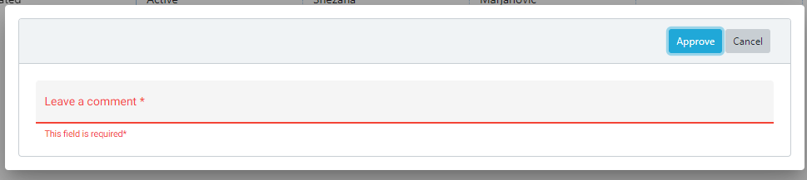
EngageMate – To Approve an Activity
9
10
Leave a comment
Created: October 2022 v1

Slide 9
Congratulations!
You have approved an activity.
To view video on “How To Review & Approve an Activity”, visit to Teva Tube:
https://vod.tevapharm.com/media/EM+Reviewer+1+-+Approving+an+Activity/1_kgfqjklx
Created: October 2022 v1

Slide 10
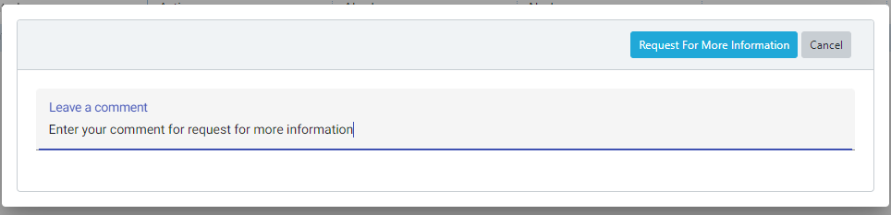
EngageMate – To Request More Information for an Activity
9
9.2
9.1
TIP: Enter detail in the comments to allow submitter’s understanding of your request
Created: October 2022 v1

Slide 11
You have now requested more information for an activity.
To view video on “How To Request More Information, as a Reviewer”, visit to Teva Tube:
https://vod.tevapharm.com/media/EM+Reviewer+2+-+Requesting+Additional+Information/1_e2ihb3uo
Created: October 2022 v1

Slide 12
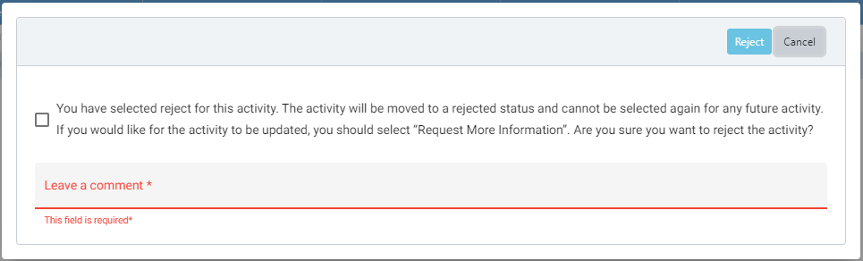
EngageMate – To Reject an Activity
9
9.3
9.1
9.2
Created: October 2022 v1

Slide 13
You have now rejected an activity.
To view video on “How To Reject an Activity, as a Reviewer”, visit to Teva Tube:
https://vod.tevapharm.com/media/EM+Reviewer+3+-+Reject+an+Activity/1_7que8k81
Created: October 2022 v1

Slide 14
EngageMate – Upload Documents during your Review
1
Created: October 2022 v1

Slide 15
EngageMate – Select your Activity to review
2
Created: October 2022 v1

Slide 16
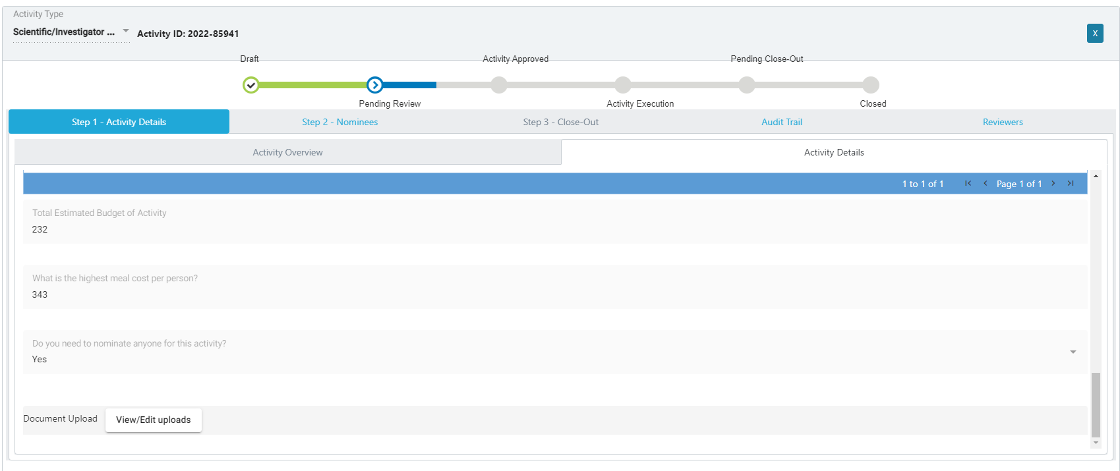
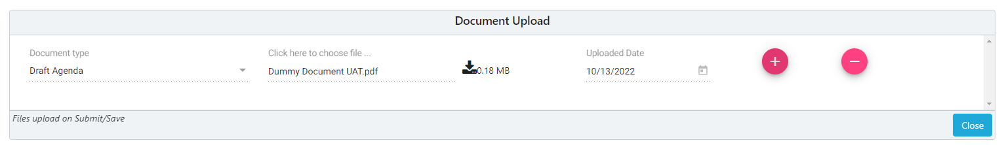
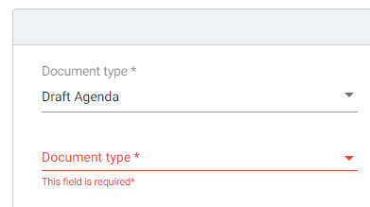

EngageMate – Upload documents during your review
4
7
3
6
5
Created: October 2022 v1

Slide 17
You have successfully uploaded documents
Created: October 2022 v1

Slide 18
EngageMate – Approve an FMV Modification
One Time Rate Change
Permanent Rate Change
Prep Time
Travel Time
1
Created: October 2022 v1

Slide 19
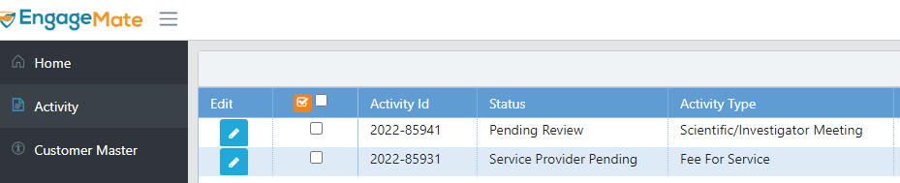
EngageMate – Locate the Activity that has the FMV Modification
2
Created: October 2022 v1

Slide 20
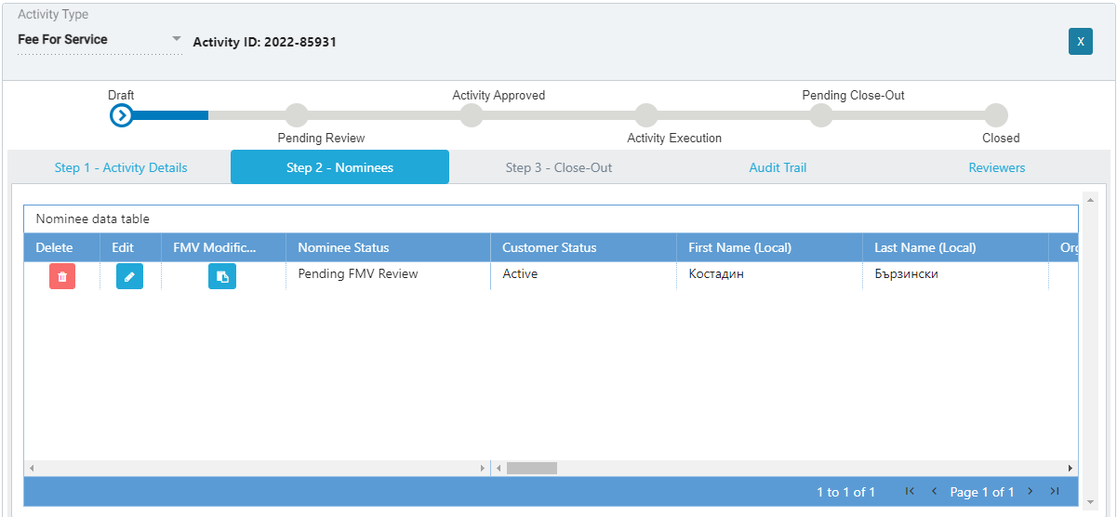
EngageMate –Open the FMV Modification
3
4
Created: October 2022 v1

Slide 21
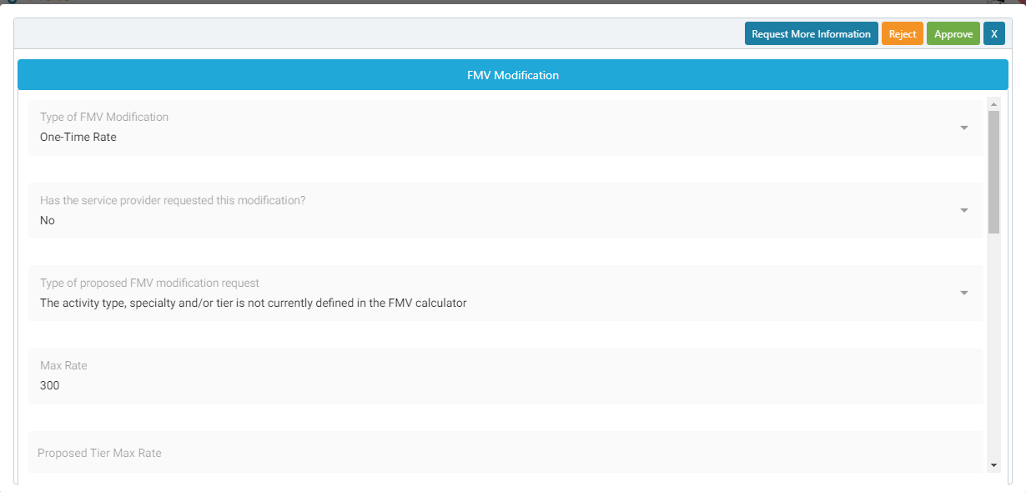
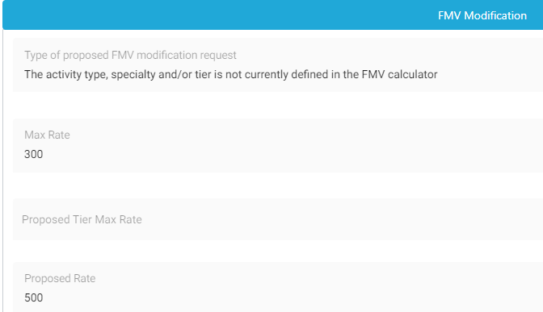

EngageMate – Review all information entered
5
6
7
This is why I am submitting this request
Created: October 2022 v1

Slide 22
EngageMate – Select your decision
8
Created: October 2022 v1

Slide 23
You have now reviewed an FMV Modification
Created: October 2022 v1

Slide 24
EngageMate – How to add additional reviewers
1
Created: October 2022 v1

Slide 25
EngageMate – Select your Activity to review
2
Created: October 2022 v1

Slide 26
EngageMate – Complete your review of the activity
3
Note: First complete your entire review of the activity and then click #3
Created: October 2022 v1

Slide 27
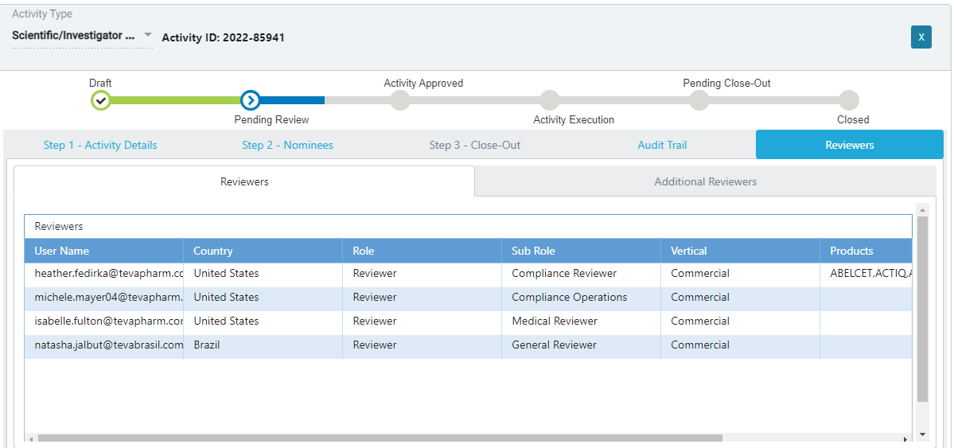
EngageMate – You want to add additional reviewers
4
Created: October 2022 v1

Slide 28
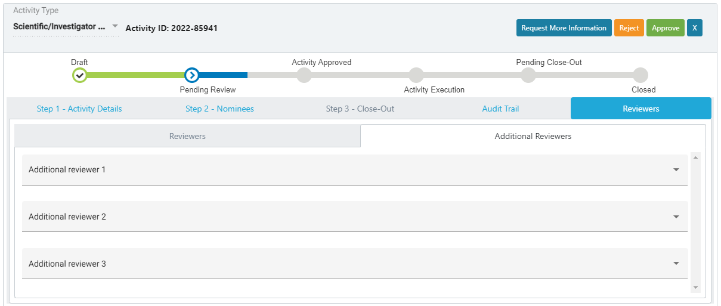
EngageMate – Select your additional reviewers
5
4
Note: Once you click approve, it will route the activity to the first reviewer and will conclude with the last one.
Created: October 2022 v1

Slide 29
You have added additional reviewers
Created: October 2022 v1

Slide 30
EngageMate – Flag an activity to monitor
1
Created: October 2022 v1

Slide 31
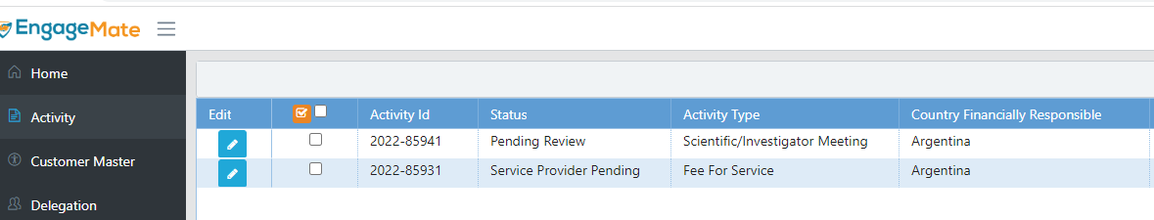
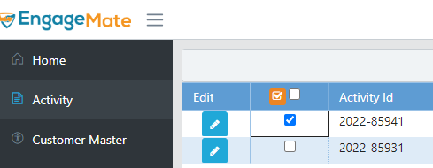
EngageMate – Flag an activity to monitor
2
3
The same functionality as you have in MonitorMate
Created: October 2022 v1

Slide 32
You have flagged an activity that you want to monitor
Created: October 2022 v1

